Slide 1
JOURNAL CLUB
ANATOMIC PATHOLOGY
HOSPITAL KUALA LUMPUR
DR KHAIRUNNISA BINTI MUHAMMAD ZUHAIDI
HOSPITAL TAIPING
23 MAY 2025 (FRIDAY)

Slide 2
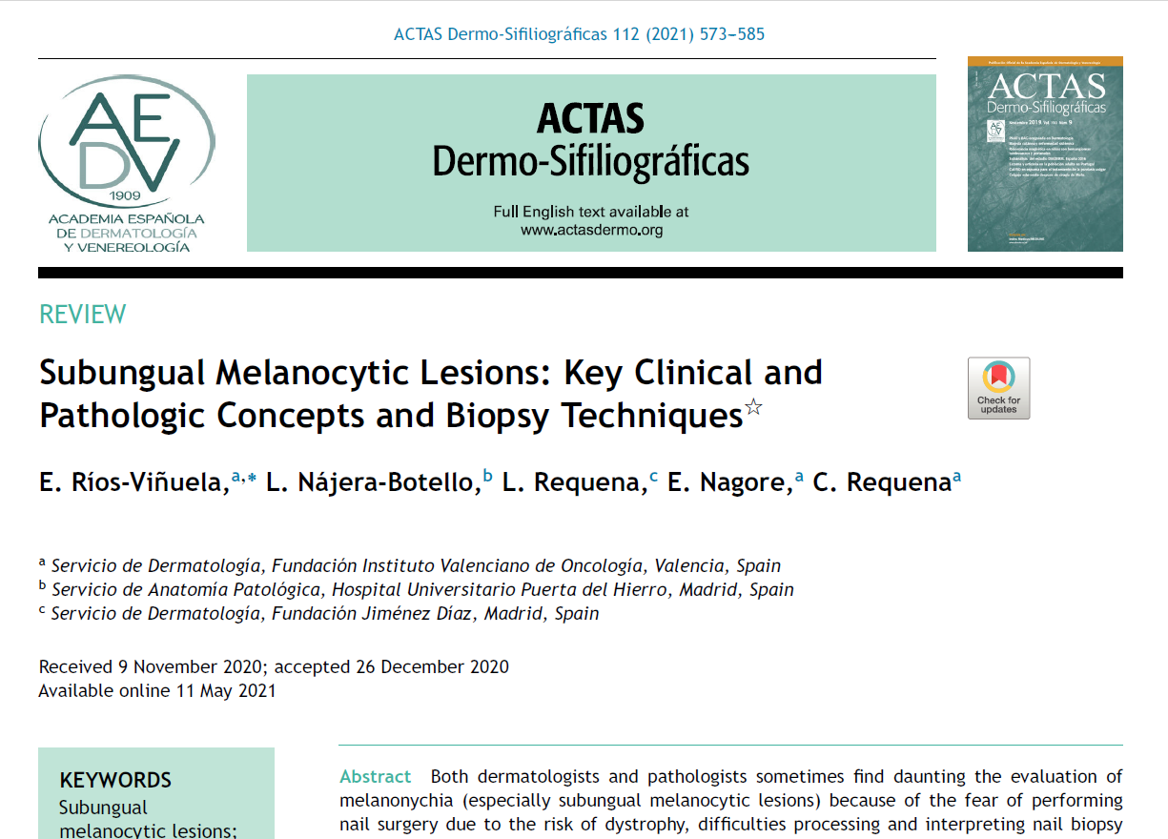
https://www.actasdermo.org/es-pdf-S1578219021001669 (Spanish Academy of Dermatology and Venereology (AEDV) Actas Dermo-Sifiliográficas in May 2021)

Slide 3
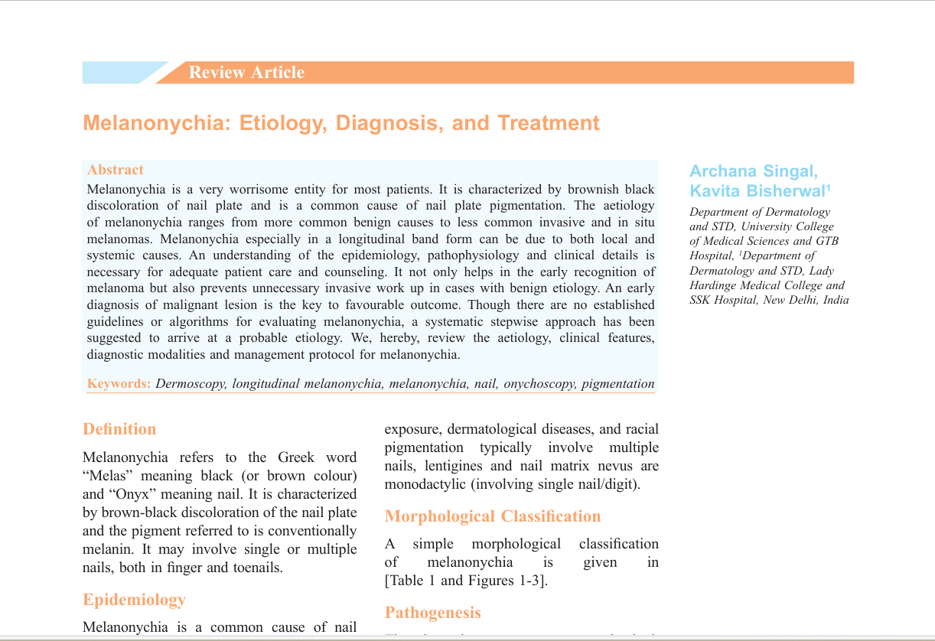
https://pmc.ncbi.nlm.nih.gov/articles/PMC7001389/pdf/IDOJ-11-1.pdf (PubMed Central National Library of Medicine National Center for Biotechnology Information in January 2020)

Slide 4
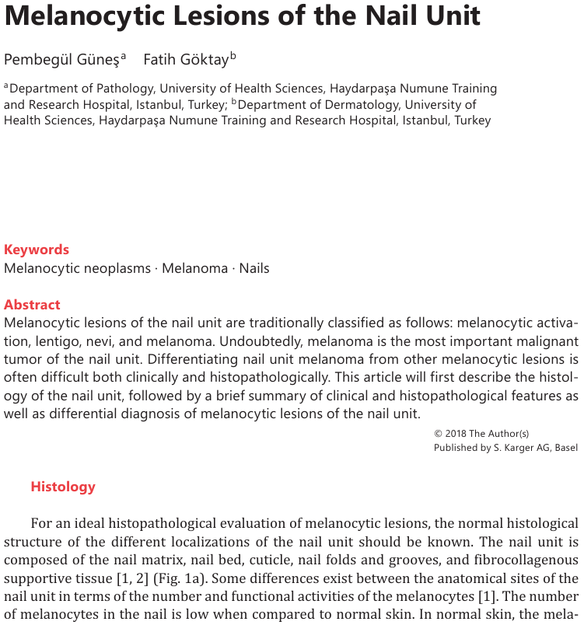
https://pmc.ncbi.nlm.nih.gov/articles/PMC6120410/pdf/dpa-0005-0098.pdf (PubMed Central National Library of Medicine National Center for Biotechnology Information in July 2018)

Slide 5
OUTLINES
INTRODUCTION
NAIL BIOPSY TECHNIQUES
CLINICAL AND HISTOLOGICAL ANATOMY OF THE NAIL APPARATUS
HISTOLOGICAL PROCESSING OF THE NAIL SPECIMEN
MELANOCYTIC LESIONS OF THE NAIL APPARATUS
CONCLUSION

Slide 6
INTRODUCTION
Traditionally, diagnosis and treatment of melanonychia has not been a fashionable topic for either dermatologists or pathologists. → Low prevalence of the lesions
Limitations among clinician (dermatologists/surgeons) and pathologists.
Clinicians:
1) Limited experience in performing procedures
2) Reticent about performing biopsies because of concerns that these may cause
nail dystrophy → partial / inadequate biopsies that may be insufficient to
obtain a reliable histologic diagnosis.
Pathologists:
1) Less experience in the interpretation of the nail biopsy specimen.
2) Inappropriate specimens due to the way the biopsy was performed.
- Nail matrix was not included in a melanocytic lesion.

Slide 7
INTRODUCTION
- The transverse instead of longitudinal orientation of the biopsy.
2) Inappropriate specimen processing and orientation. → Need special techniques

Slide 8
NAIL BIOPSY TECHNIQUES
One of the main reasons for a performing nail biopsy is to rule out subungual melanoma.
Selection of the nail biopsy techniques based on:
1) The technical difficulty.
2) Obtain a usable specimen.
3) Risk of permanent nail dystrophy.
Most melanocytic lesions lie in the nail matrix (mostly appear in the distal matrix). Therefore, this structure should be included in almost all cases.
Intraoperative nail dermoscopy (once the nail plate has been removed) is useful
for the study of longitudinal melanonychia and more precisely locate the source of
pigmentation.

Slide 9
NAIL BIOPSY TECHNIQUES
Options of the procedure:
1) Longitudinal elliptical biopsy of the nail bed.
2) Punch biopsy of the nail bed.
3) Shave biopsy of the nail matrix.
4) Punch biopsy of the nail matrix.
5) Transverse elliptical biopsy of the nail matrix.
6) Longitudinal excision biopsy of the nail apparatus.
An isolated (longitudinal elliptical / punch) biopsy of the nail bed is insufficient as the histological material of interest would not be obtained for study.
Elliptical and punch biopsies of tbe nail matrix can be performed directly or with prior avulsion of the nail plate, if the pigmentation has a small diameter.

Slide 10
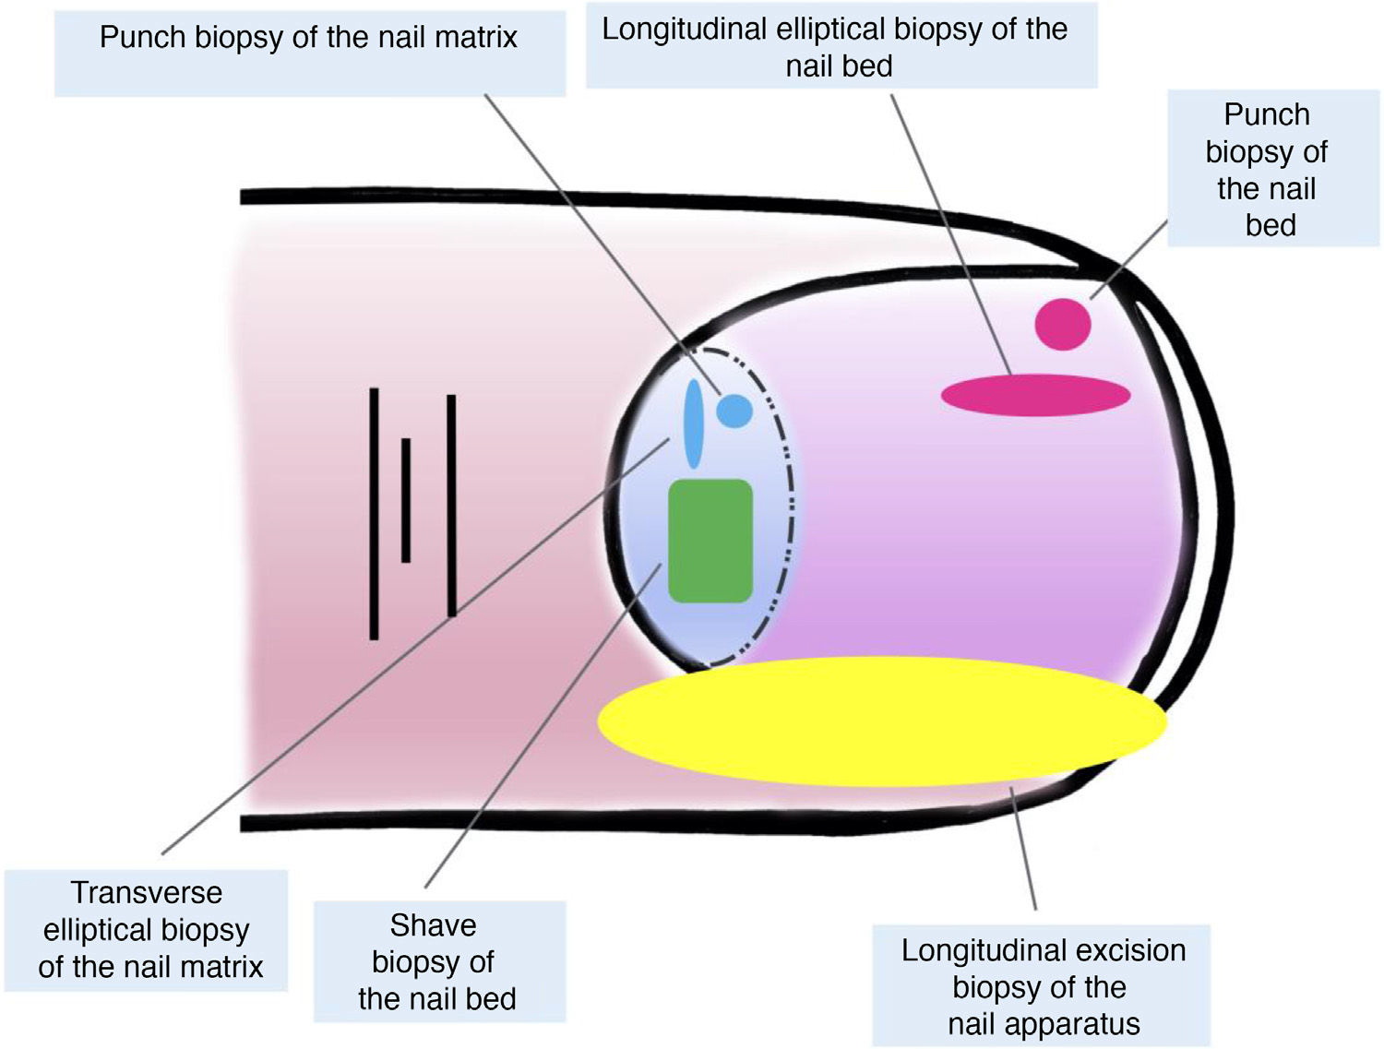
Figure 4 Technique of nail apparatus biopsy. Punch biopsies and longitudinal elliptical biopsy of the bed (pink), punch biopsiesand transverse elliptical biopsies of the nail matrix (blue), shave biopsy of the nail bed (green), and longitudinal excision biopsy (yellow).

Slide 11
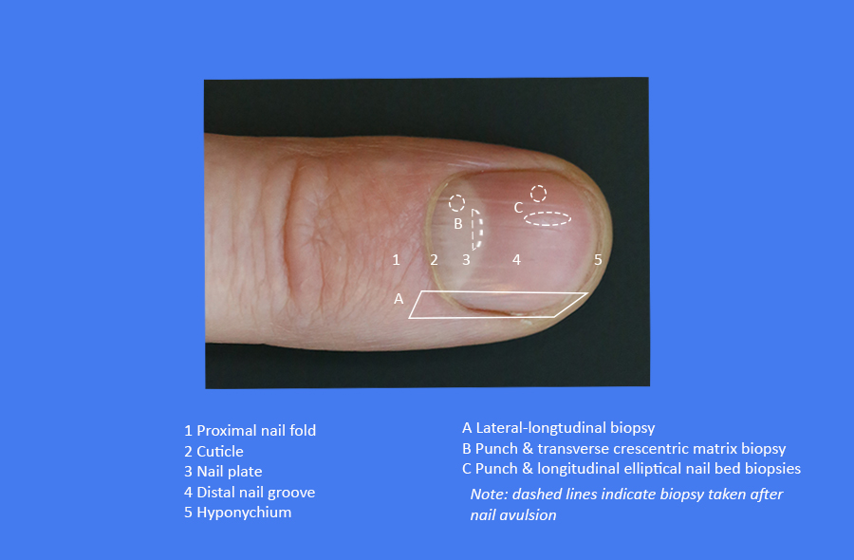

Slide 12
NAIL BIOPSY TECHNIQUES
Suitable techniques for broad pigmentations:
1) Shave biopsy of the nail matrix
-Performs after withdrawing the proximal nail fold and avulsion of the proximal
plate.
-Allows complete inclusion of the matrix and has a low risk of permanent nail
dystrophy.
2) Longitudinal excision biopsy of the nail apparatus
-The technique of choice for histological study of the nail apparatus.
-Offers the best anatomical correlation and allows study of the distribution
and architectural overview of the lesion within the nail apparatus.

Slide 13
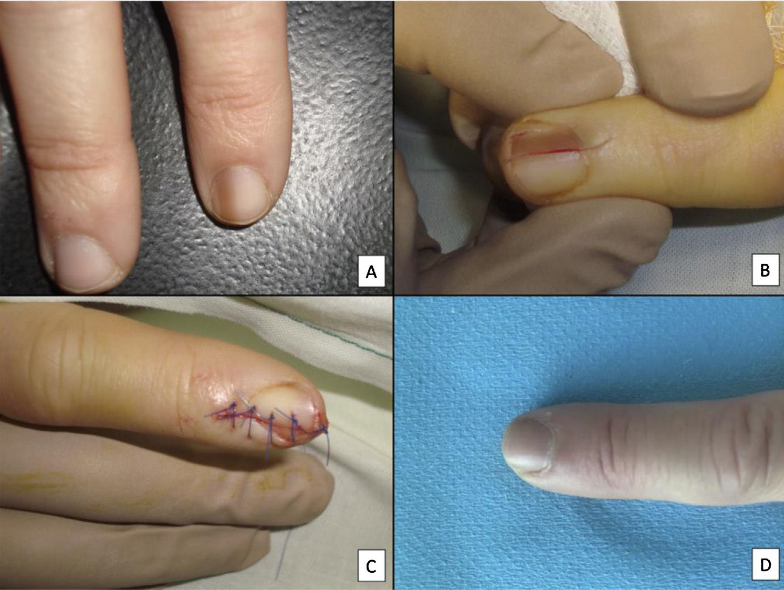
Figure 3 Longitudinal excision biopsy of the nail apparatus.
A) Pale brown longitudinal melanonychia, which histologically corresponds to nail hypermelanosis.
B) Under local anesthetic, longitudinal excision is performed in a cylindrical shape from the proximal nail fold to the hyponychium, including the entire nail apparatus.
C) Direct closure of the defect by suture from nail plate at the surface to the deep nail connective tissue.
D) After 1 year, the result is a normal nail without any sign of permanent dystrophy, just narrower.

Slide 14
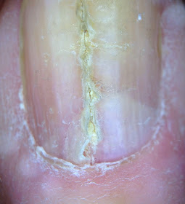
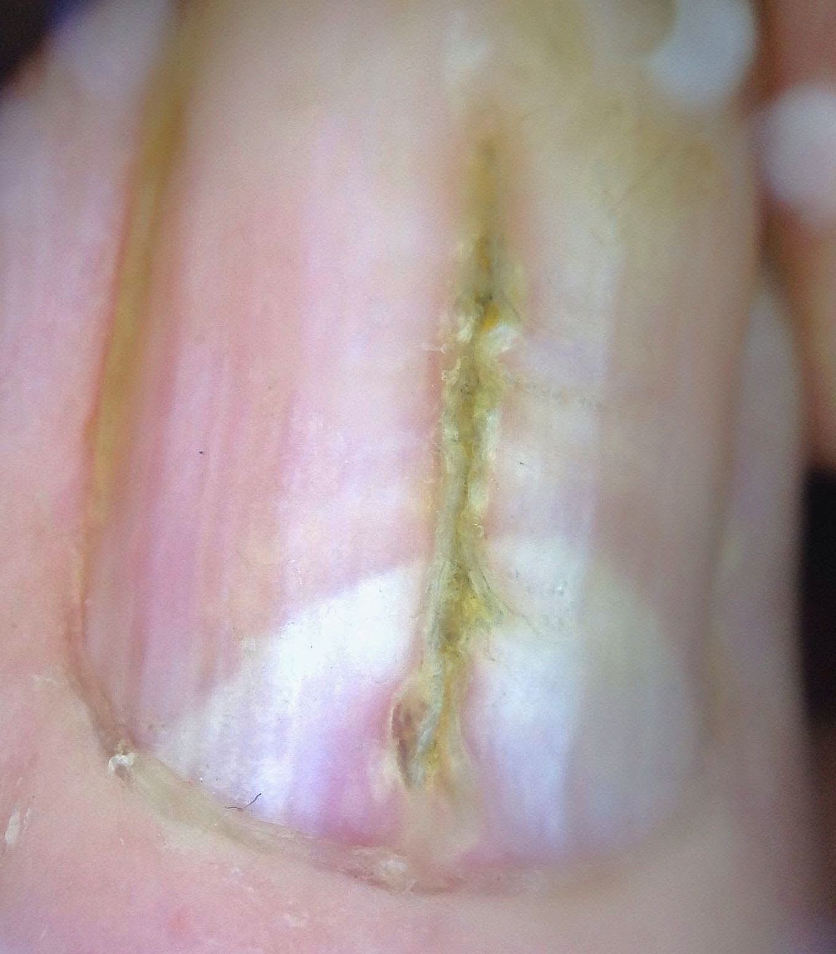
Nail plate dystrophy

Slide 15
HISTOLOGICAL PROCESSING OF THE NAIL SPECIMEN
Processing a nail biopsy is more challenging than a standard skin biopsy.
The nail plate is a very hard tissue that is difficult to cut, which often leads to
-Tractional / chattering artifacts.
-Epithelial detachments.
-Poor orientation of the cut section.
Nail specimens may need to be softened after fixation in a 10% formalin solution.
Choice of softening agents:
1) 10% potassium hydroxide.
2) 4% aqueous phenol.
3) Tween-40 / Polysorbate 40 (polyoxyethylenesorbitan monopalmitate).
4) Household products (e.g. hair removal product or fabric softner).
5) Distilled water.

Slide 16
HISTOLOGICAL PROCESSING OF THE NAIL SPECIMEN
Decalcifying agents (e.g. nitric acid or formic acid) are not recommended because they may alter the morphology and damage the genetic material of the specimen, which compromise immunohistochemical and molecular studies.

Slide 17
CLINICAL AND HISTOLOGICAL ANATOMY OF THE NAIL APPARATUS
CLINICAL (MACROSCOPIC) ANATOMY
The nail apparatus consists of the nail matrix, nail bed, nail plate, nail cuticle, and connective tissue that supports these structures.
Nail matrix
-Epithelial part, which is the most proximal part of the nail apparatus.
-Continues distally with the nail bed.
-Produce the nail plate.
Both nail matrix and nail plate are covered by the proximal nail fold.
Lunula (present in some fingers)
-Whitish convex structure in a halfmoon form.
-Most distal part of the nail matrix.
Nail bed structure is visible through the nail plate.

Slide 18
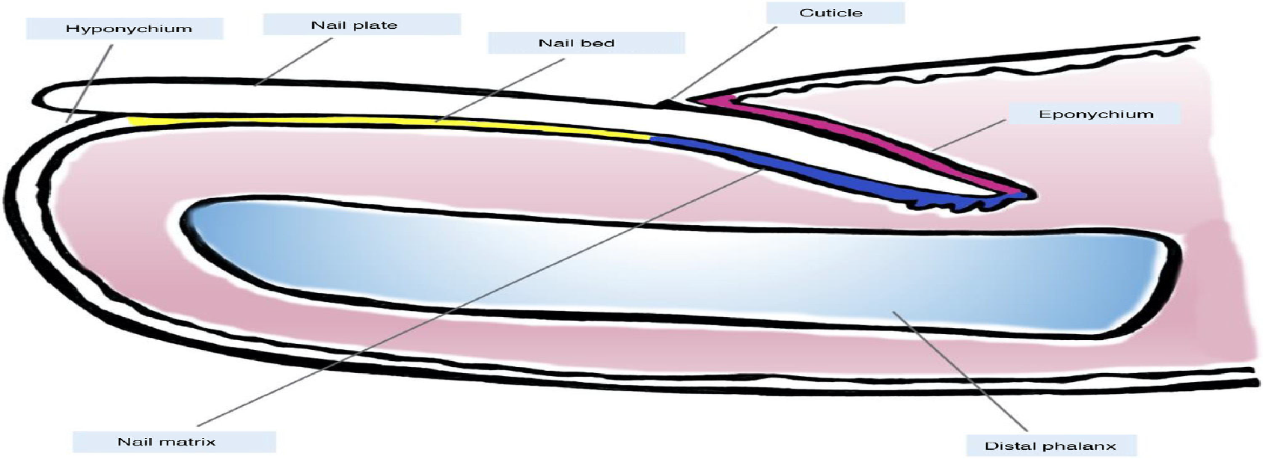
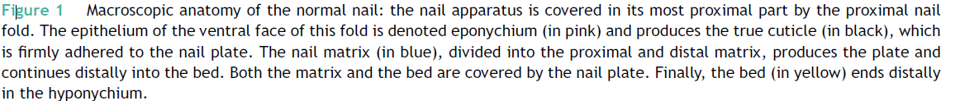

Slide 19
CLINICAL AND HISTOLOGICAL ANATOMY OF THE NAIL APPARATUS
HISTOLOGICAL (MICROSCOPIC) ANATOMY
Proximal nail fold
-Wedge-shaped skin fold (acral skin) that overlies nail plate
-Made of 2 layers of the epidermis (dorsal and ventral)
-Dorsal part→ Cuticle (part of dorsal proximal nail fold) protects nail matrix
-Ventral part→ Eponychium (epithelium of ventral proximal nail fold)
Nail matrix
-Consists of keratinizing acanthotic squamous epithelium without granular layer
under proximal nail fold
-Proximal part (keratogenous zone) contains basaloid cells that progress to larger
squamoid keratinocytes which form the nail plate after flattening, losing nuclei and
condensing (bright pink) cytoplasm
-Contains small numbers of normal active melanocytes, Merkel cells, and Langerhans cells

Slide 20
CLINICAL AND HISTOLOGICAL ANATOMY OF THE NAIL APPARATUS
HISTOLOGICAL (MICROSCOPIC) ANATOMY
Nail plate
-Consists of dense layer of interdigitating polyhedral keratinocytes devoid of nuclei
(keratogenic band)
Nail bed
-Flattened squamous epithelium (3 cell layers thick) with inactive melanocytes
beneath the nail plate
Hyponychium
-Distal nail bed epithelium under nail plate between free edge and skin of finger tip
-Made of acanthotic squamous epithelium with very dense keratin layer and
prominent granular layer

Slide 21
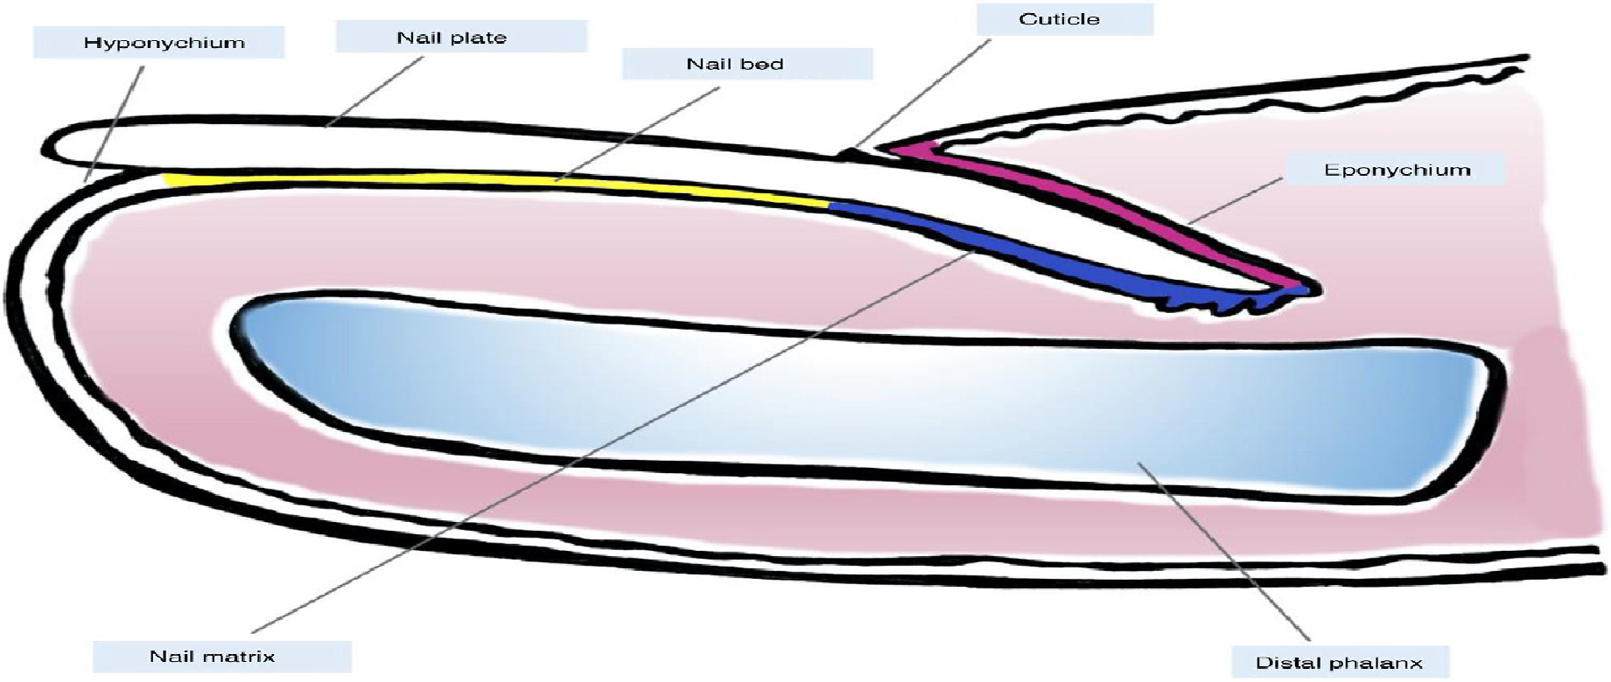
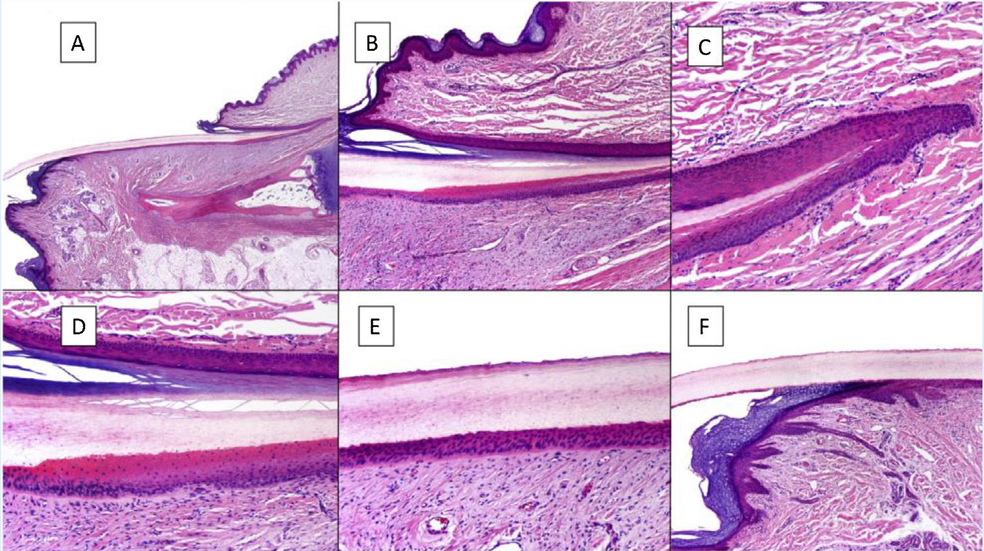
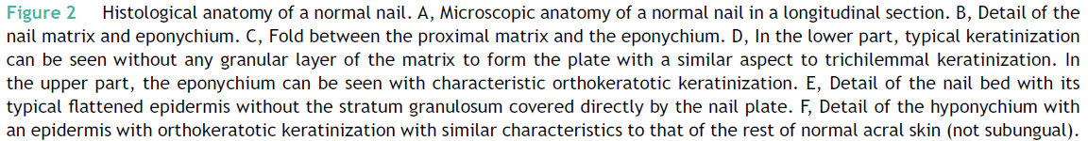

Slide 22
MELANOCYTIC LESIONS OF THE NAIL APPARATUS
Normal melanocytes in the nail apparatus is almost 6x lower than in normal skin (200/mm2 vs 1150/mm2)
Melanocytes distribution:
1) Eponychium and nail bed
-Scarce in a quiscent state located the basal layer of the epithelium (0-50/mm2).
2) Nail matrix
-Proximal part :
>Thickest epithelium (basaloid epithelial cells of 4-10 cell layers).
>Higher density of melanocytes (100-200/mm2) in a quiscent state and hardly
produce melanin, located in the basal and suprabasal layers of the epithelium.
>Melanocytes can only ascend to the prekeratogenous zone (NOT the
keratogenous zone).
]

Slide 23
MELANOCYTIC LESIONS OF THE NAIL APPARATUS
-Distal part:
>Epithelium consists of 2-3 cell layers.
>Melanocytes are located in the basal layer of the epithelium.
>More active produces melanin (about 50%) → most pigmented melanocytic
lesions arise in the distal nail matrix (up to 85%) .
Immunohistochemical staining is needed to visualize melanocytes.
SOX10 and MiTF (nuclear staining) are preferable than MelanA and HMB45
(cytoplasmic staining). S100 is not recommended.

Slide 24
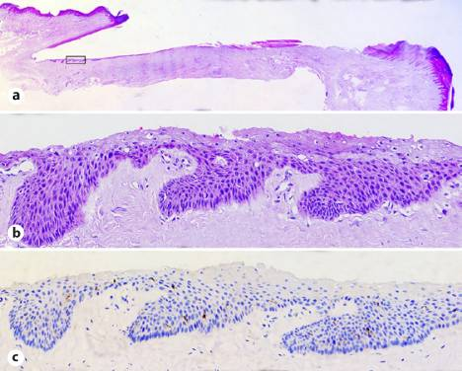

Slide 25
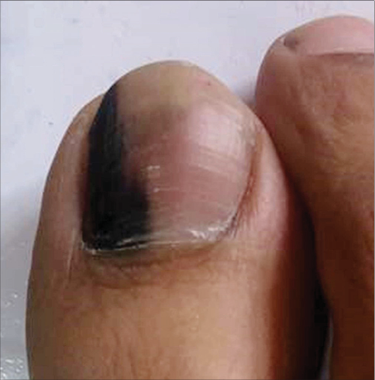
MELANOCYTIC LESIONS OF THE NAIL APPARATUS
Most melanocytic lesions present as a longitudinal melanonychia (known as melanonychia striata)
Longitudinal melanonychia
-Pigmented band that extends from the nail matrix to the free border of nail plate
-Occasionally, melanonychia occupying the entire width in the nail plate
-Not exclusive to melanocytic lesions, can be due other causes include racial
pigmentation, pregnancy, infection, drug-induced, exogenous pigmentation, tumours
and others
-Atypical clinical signs (suspicious for melanoma)
1)Broad heterogeneous melanonychia (>5mm in diameter) composed of different
bands of colours with poorly defined borders
2) Rapid progression
3) Nail dystrophy
4) Triangular form (broader in the proximal part than the distal part)

Slide 26
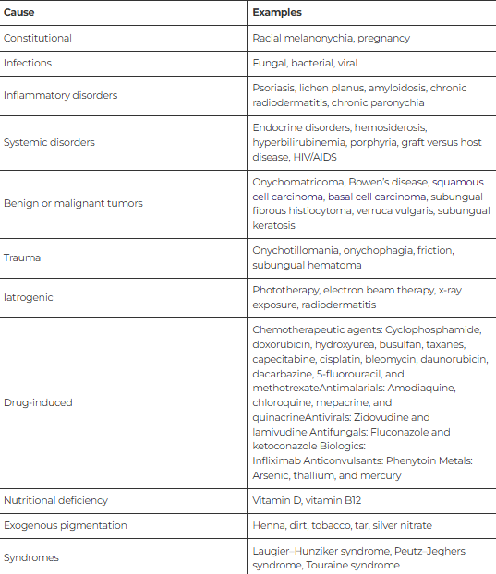
Etiologies of melanonychia

Slide 27
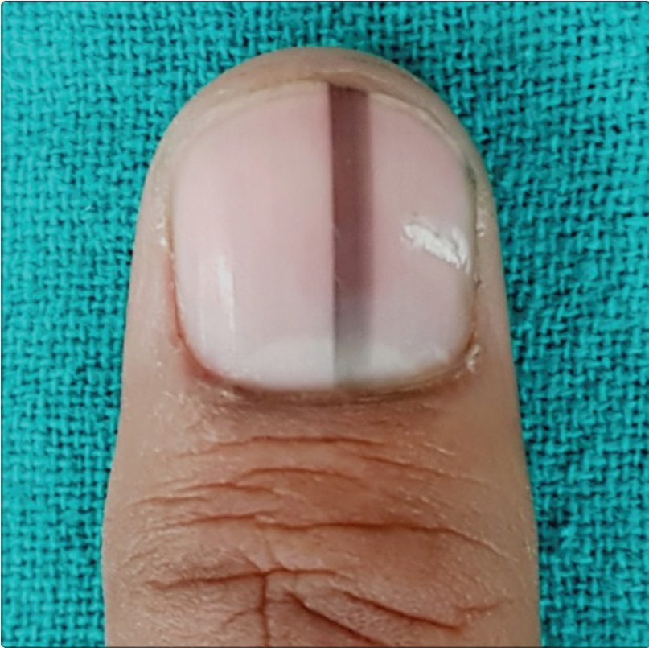
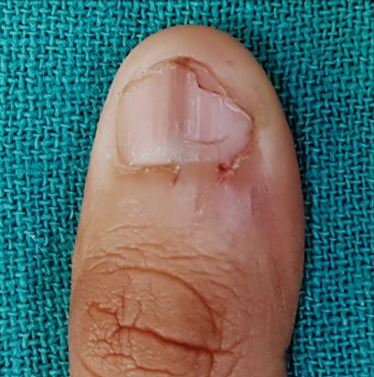
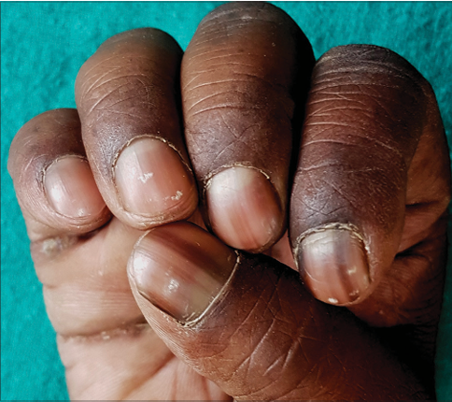
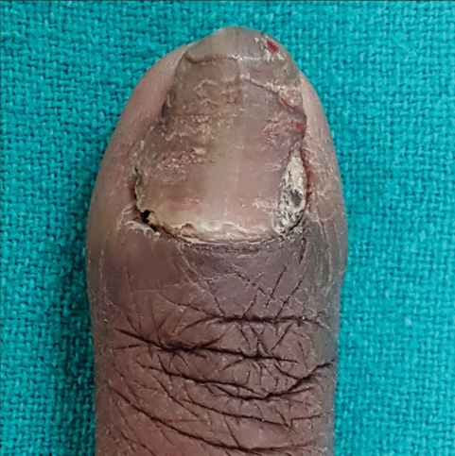
Longitudinal melanonychia in patient with onychophagia (nail biting)
Isolated longitudinal melanonychia
Racial melanonychia
Fungal melanonychia

Slide 28
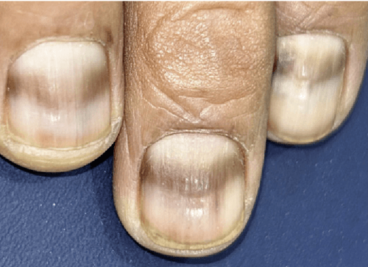
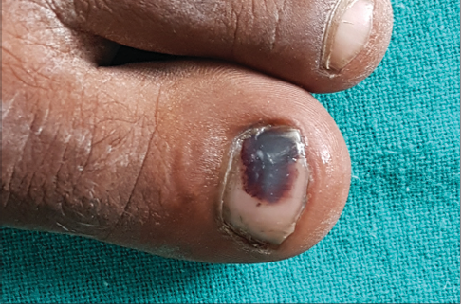
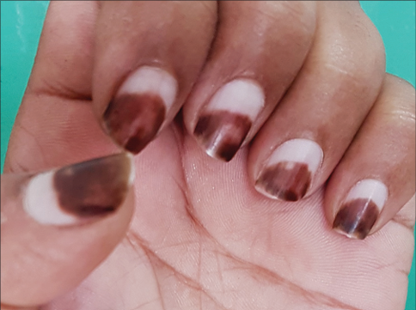
Transverse melanonychia in CML patient receiving chemotherapy (Desatinib)
Melanonychia due to subungual haematoma
Melanonychia due to exogenous pigmentation (Henna)

Slide 29
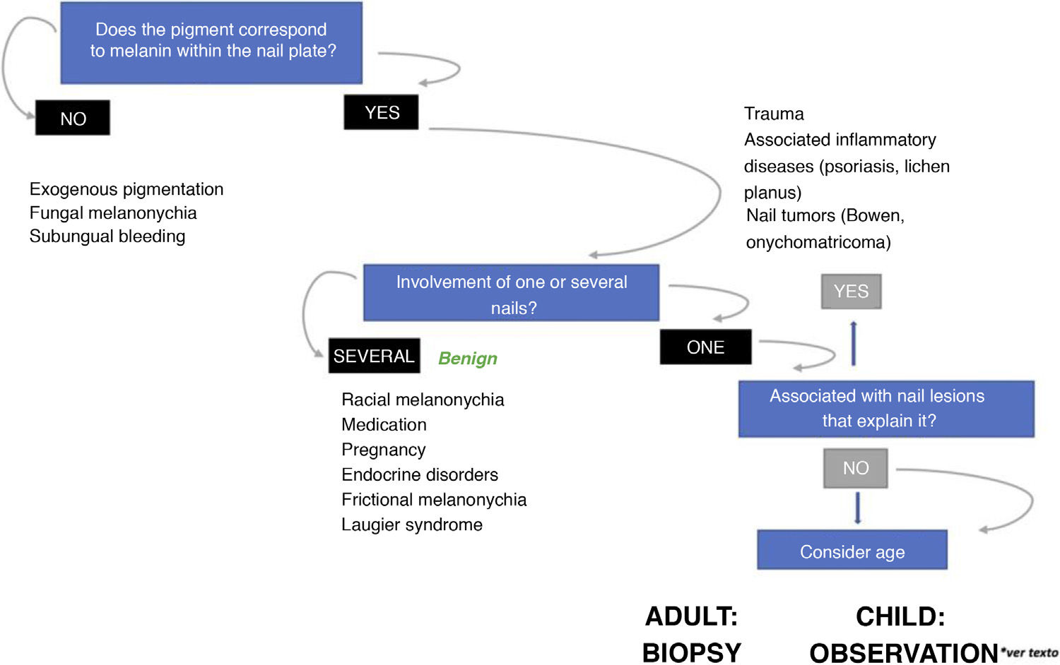

Slide 30
MELANOCYTIC LESIONS OF THE NAIL APPARATUS
Melanocytic hyperactivation
-Known as nail hypermelanosis
-Most frequent cause of longitudinal melanonychia in adults (up to 73% of cases)
-Narrow bands (<5mm in diameter) with a greyish or light brown colour
-Activation of the suprabasal layer melanocytes in the proximal matrix and basal
layer melanocytes in the distal matrix
(WITHOUT increase in the number of melanocytes)
→ Increase melanin pigmentation in the matrix epithelium

Slide 31
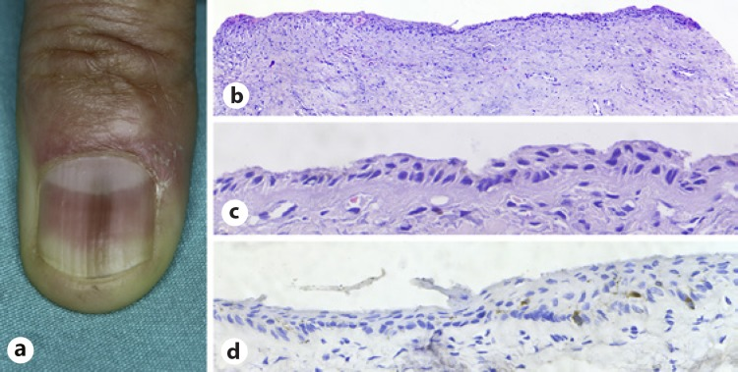
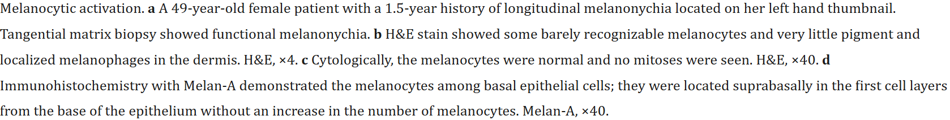

Slide 32
MELANOCYTIC LESIONS OF THE NAIL APPARATUS
Subungual lentigo
-Known as benign melanocytic hyperplasia / melanotic macule.
-More common in adults.
-An increased number of melanocytes (melanocyte proliferation) distributed in the
basal layer of the matrix epithelium with a lentiginous growth pattern (WITHOUT
forming nests).
-Longitudinal melanonychia >5mm in diameter or can occupied the entire nail.
-Microscopically,
>An increased number of melanocytes (normal/mild cytological atypia) aligns
individually in the basal layer of the matrix epithelium (rarely localized suprabasally).
* Presence of isolated suprabasal melanocytes in the matrix epithelium NOT
considered a pathological finding.
>Melanin pigmentation is seen in both matrix epithelium and nail plate.

Slide 33
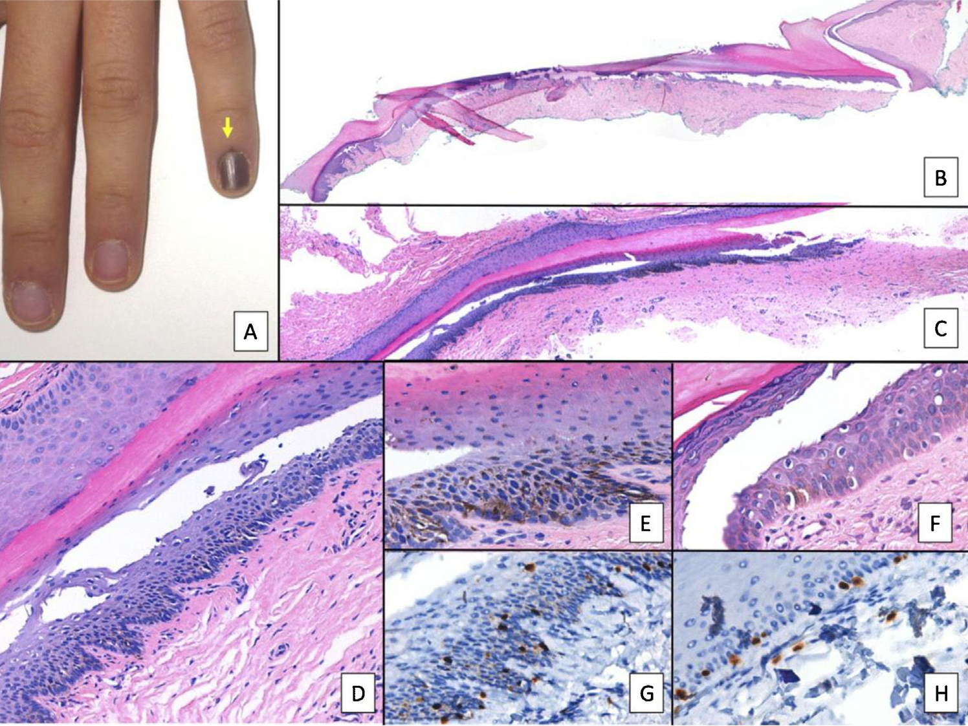
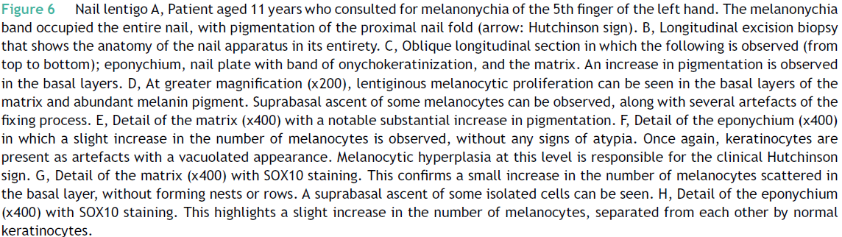

Slide 34
MELANOCYTIC LESIONS OF THE NAIL APPARATUS
Melanocytic Naevus
-Benign melanocytic hyperplasia, either congenital or acquired.
-Most common melanocytic nail lesion in childhood (about 75%).
-Clinically presented as regular longitudinal pigmented band (melanonychia) on the
nail plate.
-Pigmentation of the proximal nail fold and cuticle (Hutchinson sign) in congenital
melanocytic naevus → NOT suggestive of malignancy.
-Melanocytic naevus in infancy may have atypical clinical presentation
(broad/irregular melanonychia), Hutchinson sign not associated with melanoma and
complete melanonychia).
-Histopathologic subtypes:
1)Junctional naevus (most frequent)
2)Blue naevus, Spitz naevus, and compound naevus (rare)

Slide 35
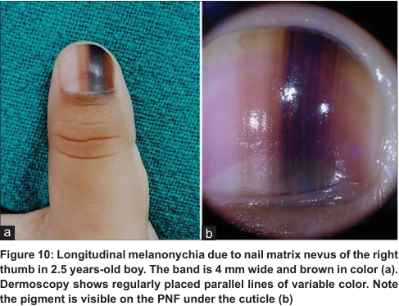
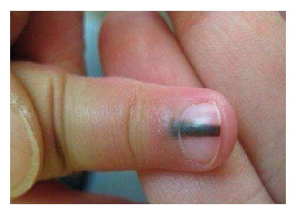
Hutchinson sign in a melanocytic naevus

Slide 36
MELANOCYTIC LESIONS OF THE NAIL APPARATUS
Melanocytic Naevus
-Microscopically, melanocytic proliferation is characterized by the formation of nest
of melanocytes that occupy the basal layer of the matrix epithelium.
>Given the firmness of the overlying nail plate, the melanocytic nests can be
squashed and confluent as observed in longitudinal excision biopsy.
>Mild cytological atypia (nuclear size of a melanocyte = keratinocyte nucleus).
>In the common blue naevus, a dark pigmented melanocytic proliferation occurs
in the superficial dermis.
>Signs of atypical melanocytic proliferation:
1) Pagetoid spread of individual atypical melanocytes.
2) Angular-shaped nucleus, dense chromatin, and polymorphism in different areas.

Slide 37
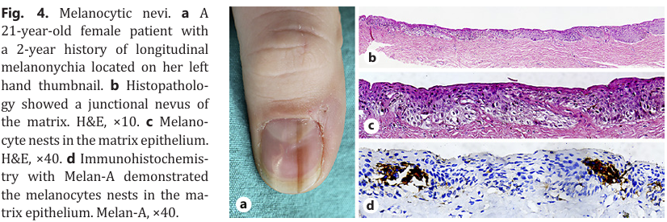

Slide 38
MELANOCYTIC LESIONS OF THE NAIL APPARATUS
Nail (Subungual) Melanoma
-Uncommon tumour (constitute 1.5–2.5% of all melanomas).
-Usually occur in adults (common at aged 50-70 years) and very infrequent in
children (range 6 months to 16 years).
-Generally, subungual melanomas arise de novo, and a benign melanocytic nevus
does not precede their development.
-The role of UV penetration is insignificant than in cutaneous melanomas.
-The cytokines produced by growth factors that are evoked during chronic
inflammation play an important role in melanocyte proliferation and angiogenesis.
→More common in black people and Asian people
-Clinical findings (signs of atypical longitudinal melanonychias)
1) Longitudinal melanonychia >5 mm.
2) First nail involvement (thumb of the dominant hand and big toe.

Slide 39
MELANOCYTIC LESIONS OF THE NAIL APPARATUS
Nail (Subungual) Melanoma
3)Single nail involvement.
4)Enlargement of the pigmented band from distal to proximal (triangular form).
5)Nail plate dystrophy (25% in amelanotic melanoma).
6)Periungual pigmentation in adults (Hutchinson sign caused by spread of tumour
cells to the proximal nail fold or the hyponychium).
7)Abnormal pigmentation may be accompanied by nail plate atrophy and
fissure.
8) Nodule formation and ulceration.
-The disease most commonly arises from the matrix and less frequently from the nail
bed.

Slide 40
MELANOCYTIC LESIONS OF THE NAIL APPARATUS
Nail (Subungual) Melanoma
-Histopathologic variants:
1)Acral lentiginous melanoma (most frequent).
2)Others; superficial spreading melanoma and nodular melanoma.
-Histopathologically, the diagnostic criteria for in situ melanoma are:
>Infiltrative edge.
>Increased intraepidermal melanocyte proliferation.
>Increased suprabasal melanocytes.
>Irregular distribution and asymmetry of melanocytes.
>Tendency of fusion in nests.
>Cytological atypia.
>Dermal lymphoid cell infiltration.

Slide 41
MELANOCYTIC LESIONS OF THE NAIL APPARATUS
Nail (Subungual) Melanoma
-Acral lentiginous melanoma:
>An increased number of atypical melanocytes (large with hyperchromatic nuclei).
>Irregularly distributed in the basal layer of the matrix epithelium, or less frequently
in the nail bed
>Formation of melanocytic nests (late course)
>Disordered pagetoid spread may be accompanied by the presence of atypical
melanocytes in the nail plate
>Dermal lymphocytic infiltrate (not found in melanocytic naevus)
>Multinucleation
>A significant increase in melanocytic density (only moderate melanocyte intensity
in subungual lentigo and melanocytic naevus)

Slide 42
MELANOCYTIC LESIONS OF THE NAIL APPARATUS
Nail (Subungual) Melanoma
>Lentiginous spread of atypical melanocytes towards the eponychium or
hyponychium (indication for invasion of surrounding structures).
>It shows characteristics similar to invasive cutaneous melanoma at other sites when
subungual melanoma becomes invasive.
-Poor prognostic parameters (older age, ulceration, high mitotic index, amelanotic
tumour, and advanced stage of disease).
-The same AJCC staging system is used for both skin and nail melanomas.
-Role of mmunohistochemistry:
1)Ki-67 shows proliferative activity, it is valuable for differentiating between benign
and malignant tumours

Slide 43
MELANOCYTIC LESIONS OF THE NAIL APPARATUS
Nail (Subungual) Melanoma
2)SOX10 and MITF1 nuclear positivity helpful in:
-Distinguish desmoplastic melanoma from fibroblastic and histiocytic mesenchymal
tumours
-Differentiate melanocytes from keratinocytes
-Melanin pigment and melanosomes cannot be demonstrated by these stains
-Molecular analysis is necessary in metastatic and nonresectable tumours to
determine their medical therapy:
*Ckit mutation (10–30%) is the most common genetic change with BRAFV600
(10–15%) and NRAS (10–15%) mutations in acral melanoma

Slide 44
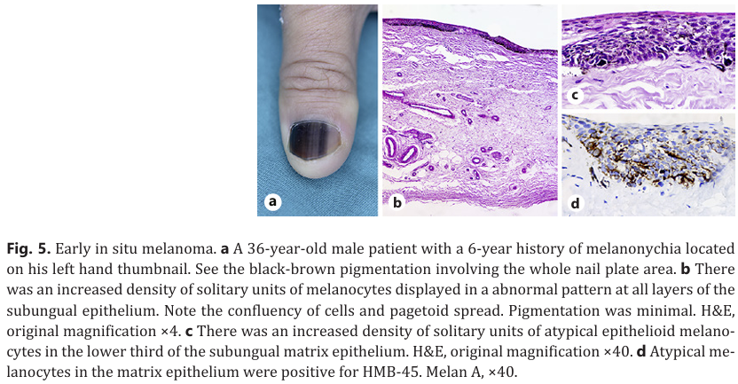

Slide 45
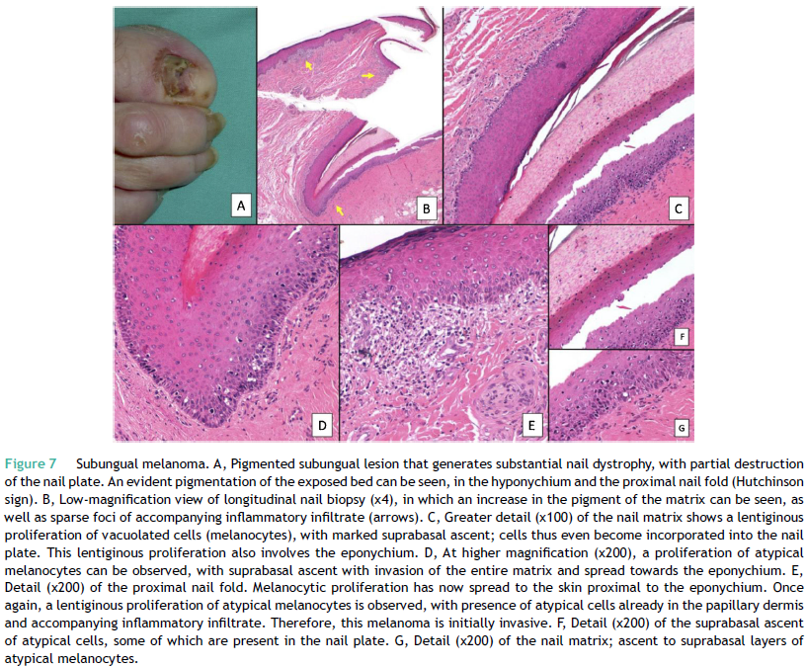

Slide 46
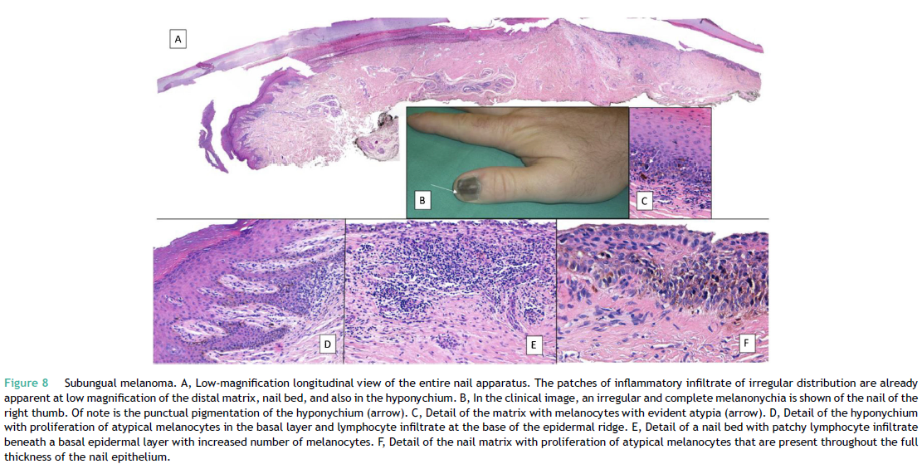

Slide 47
CONCLUSION
Study of melanocytic lesions of the nail is complex and may represent a challenge both for dermatologists and pathologists.
Clinical and epidemiological data can be as useful besides histopathological findings in making diagnosis of melanocytic lesions
The simplest interpretation of subungual melanocytic lesions is achieved with a longitudinal biopsy that includes the entire nail apparatus.

