Slide 1
ANATOMIC PATHOLOGY JOURNAL CLUB 2025
Pitfalls in Lymph Node Fine Needle Aspiration Cytology
DR MASTURAH BINTI RAMLI
HOSPITAL TELUK INTAN

Slide 2
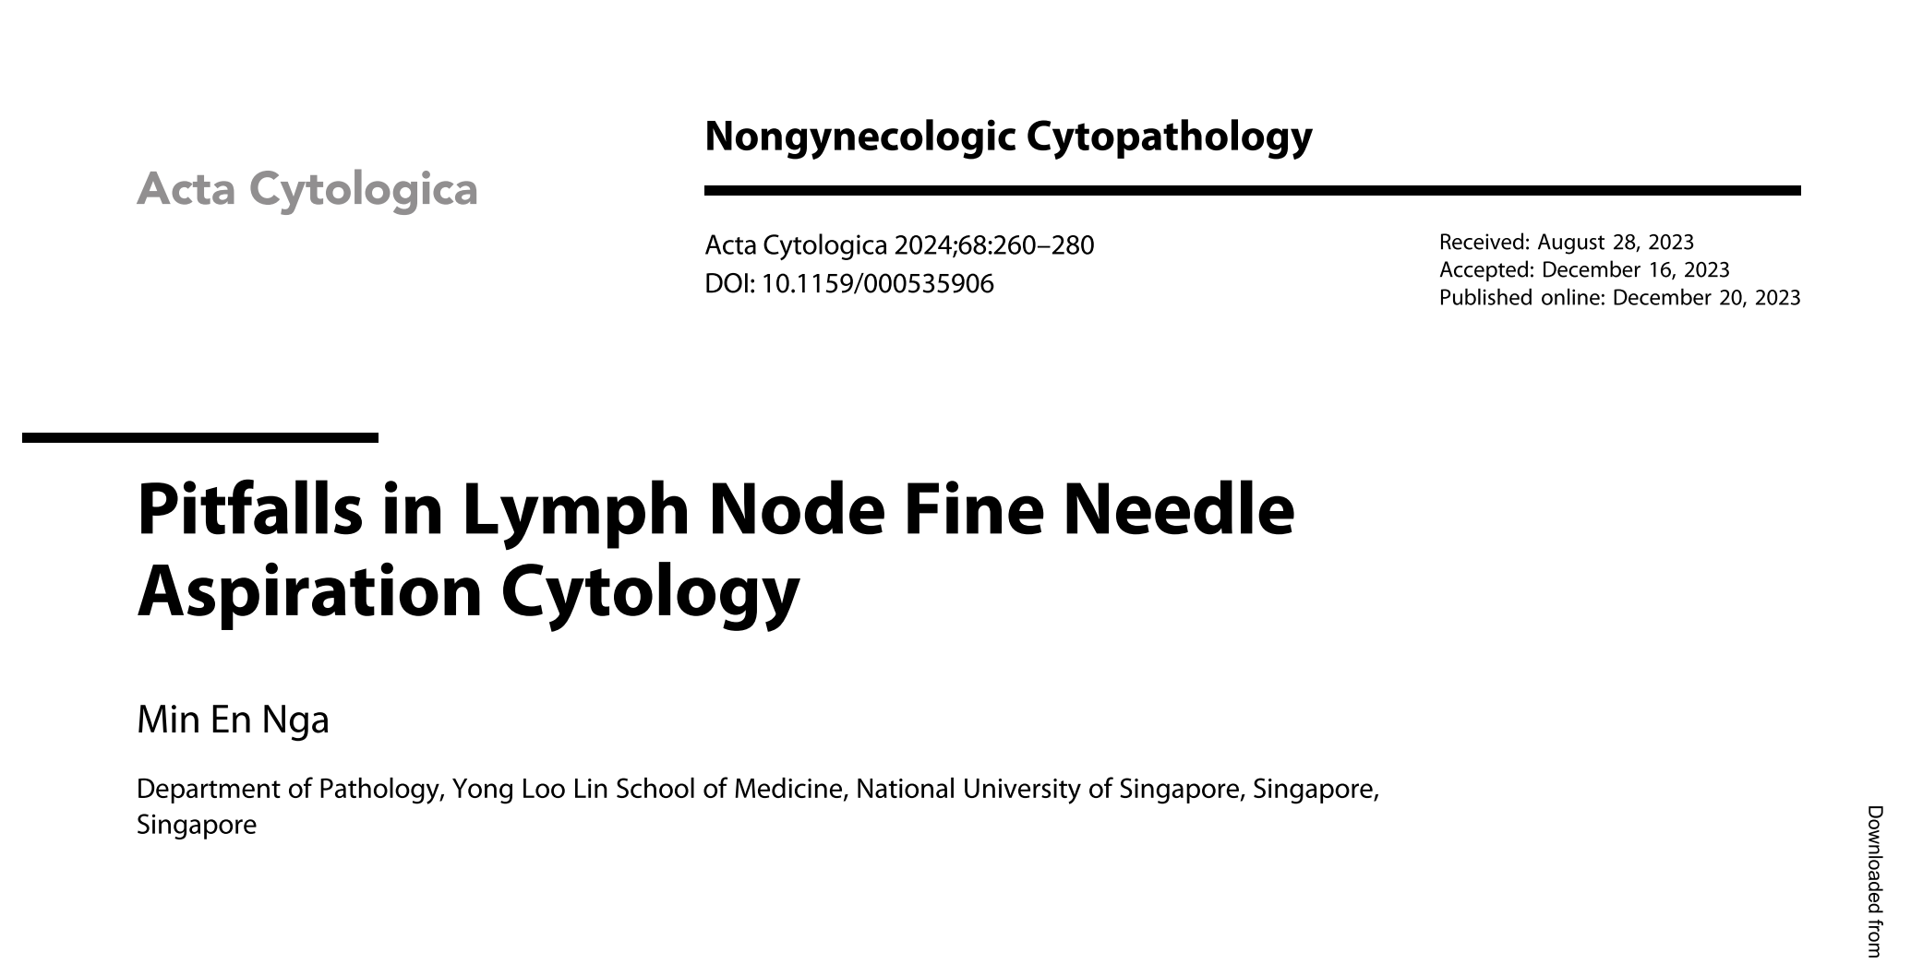

Slide 3
OUTLINE
INTRODUCTION
BACKGROUND
FALSE NEGATIVE
FALSE POSITIVE
REACTIVE LYMPHOD LESIONS THAT MIMICS LPD
MISCLASSIFICATION OF TUMOUR

Slide 4

INTRODUCTION AND BACKGROUND

Slide 5
Introduction
FNAC is is well-recognised for diagnosing reactive, infectious conditions and metastatic cancers, its role in identifying lymphoproliferative disorders (LPDs) remains debated within the pathology community.
In 2020, Zeppa et al. introduced a new International (WHO) System for Reporting Lymph Node Cytology, building on the Sydney System proposed earlier that year, aims to to improve acceptance and utilisation of lymph node cytology as a diagnostic procedure.
One principles behind accurate diagnosis is the awareness of potential pitfalls, such as common false-negative (FN) or false-positive (FP) diagnoses, frequently misclassified entities, as well as less common entities that may fall under the radar

Slide 6
Background
Use of FNAC - diagnosis of reactive and infectious conditions, metastatic malignancy, which is facilitated by ancillary testing on cell block (CB) material.
Its diagnostic utility in LPDs varies based on cytopathologist expertise, available ancillary tests, and multidisciplinary clinical practices.
In settings with limited access to personalized medicine or targeted therapies, molecular subtyping may hold less clinical relevance compared to tertiary referral centers.
  FNAC with basic ancillary testing or immunophenotyping using flow cytometry (FC) or immunocytochemistry (ICC) may be sufficient.
In tertiary centres, definitive diagnosis may involve excisional, core, or FNAC with ancillary testing. With growing use of molecular subtyping and targeted therapy, reliance on smaller samples like FNAC is increasing.
FNAC or core biopsy is also suitable for inaccessible nodal sites or when invasive procedures are not feasible.
Morphological assessment is still the starting point for both initial triage and definitive diagnosis.
In this review, pitfalls are classified into four main groups:
  FNs (i.e., malignancies that may be missed on cytologic evaluation),
  FPs (i.e., benign conditions that are erroneously diagnosed as malignant),
  neoplasms prone to misclassification, and
  off-radar entities that may be missed because of their rarity.

Slide 7
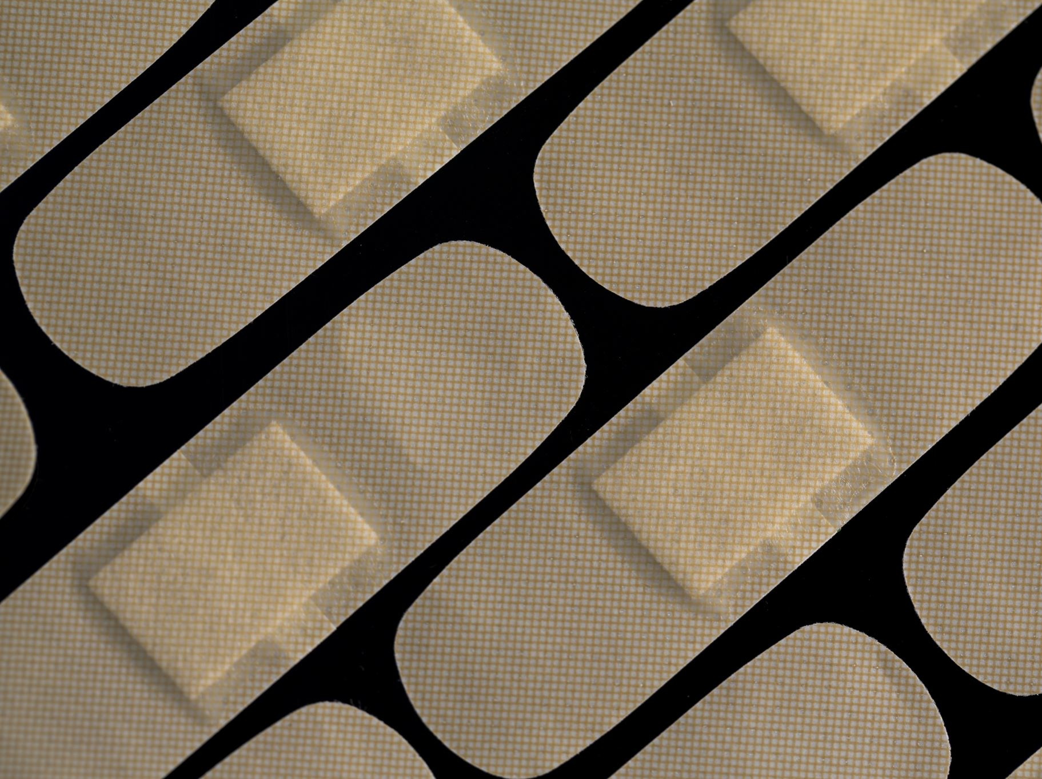
FALSE NEGATIVE

Slide 8
FALSE NEGATIVE
Can occur In Pre-analytical phase (procedure and specimen processing). Analytical phase (cytological interpretation)Post-analytical phase (e.g., report writing).
In the preana phase, sample adequacy and smear preparation are main considerations.
FNACs should be performed by a trained individual, preferably with realtime feedback on sample adequacy, accompanied by optimal sample triage.
ROSE important in determining specimen adequacy and plays key role in onsite specimen triage – e.g., determining the need for CB or collection of fresh material for ancillary testing.
  Microbiology: fresh, sterile material, flow Cytometry (FC): fresh cell suspension (preferably in RPMI or saline), Cell Blocks (CB): useful for lymphoma, metastasis, non-nodal lesions.

Slide 9
FALSE NEGATIVE
Adequate cellularity threshold are difficult to defined
  In suspected lymphoid lesion - numerous well-preserved, well-stained lymphocytes is Important. Because relative proportions of the different types/sizes of lymphoid cells is important to determine reactive or neoplastic.
  An inadequate diagnosis would prompt further investigation, as opposed to an FN diagnosis which may result in delayed diagnosis and treatment.
  If infectious aetiology or malignant cells seen - requirement for cellularity is lower, but there is a greater requirement for obtaining material for ancillary testing, e.g., fresh material for microbiological examination or CB for ICC, special stains, and molecular testing.

Slide 10
False Negatives
For each pass, both air-dried and alcohol-fixed smears should be prepared
  – lymphoglandular bodies (LGBs) are best appreciated on air-dried smears, and nuclear chromatin is more readily evaluated in alcohol-fixed smears
In the setting of adequately cellular and optimally processed smears, certain scenarios inherently result in a higher likelihood of underdiagnosis.
These fall into 3 main categories:
1. Malignancies in which the lesional or diagnostic material is scant or mixed with non-neoplastic cells
2. LPDs with a mixed lymphoid population
3. Overlapping findings in benign and malignant conditions

Slide 11
Malignancies in which the lesional or diagnostic material is scant or mixed with non-neoplastic cells
Partial Node Involvement:
  Metastasis or lymphoma may only partially involve node.
  Multiple passes recommended for large/heterogeneous nodes.
Lymphomas with Sparse Diagnostic Cells:
  Classic HL, NLPHL, THRLBCL, ALCL.
  In NLPHL
    small lymphocytes predominate, mimicking a benign low-power appearance.
    LP cells may be sparse or mimic immunoblasts, not displaying the characteristic large “popcorn” cell appearance with multilobated nuclei
  In classic HL, NLPHL, and THRLBCL, the neoplastic cells form a minority of the cell population, - FC may not reveal an abnormal cell population.

Slide 12
Fibrosis/Sclerosis
  Leads to low cellularity and paucity/absence of diagnostic cells.
  Seen in nodular sclerosis HL, metastatic carcinoma with desmoplasia.
  Scant cellularity in large nodes can be important clues/ red flag.
    low threshold for further investigation, such as imaging and tissue biopsy (core or incisional biopsy).
  Some nodal sites such as inguinal or axillary lymph nodes may be prone to fibrosis or sclerosis
Cystic lymph nodes:
  a sample labelled as a “cystic lymph node” is never a normal or reactive lymph node
  may represent a benign non-nodal lesion (branchial or lymphoepithelial cyst or cystic lymphangioma;) or a malignant lesion (cystic metastasis)
  papillary thyroid carcinoma and squamous cell carcinoma (SCC) are well known to present with cystic metastases.

Slide 13
HPV-Associated OPSCC
  classically presents with large cystic cervical nodes.
  The primary tumour may be small/undetectable. Sparse lesional cells despite large nodal size.
  CB with ICC to identify squamous epithelial cells, and p16 as surrogate marker of HPV related SCC.
“Red flag” clinical findings:
  Age >40, Nodes > 1.5–2 cm, matted, round, deep-seated or supraclavicular nodes.
  Imaging: loss of fatty hilum, necrosis , cystic changes, peripheral vascularity,
  Symptoms: Persistent/progressive lymphadenopathy, fever, weight loss, history of malignancy.

Slide 14
Other morphological clues:
A mixed cell population with predominantly small lymphocytes but where eosinophils and plasma cells are also identified → look for Hodgkin/Reed-Sternberg (HRS) cells.
Small epithelioid granulomas can be seen in classic HL; generally smaller than in infection-related necrotising granulomatous lymphadenitis
A subtle clue in classic HL and NLPHL : the large, abnormal HRS or LP cells tend to stand out in contrast to the surrounding small lymphocytes,
  In comparison- In a reactive condition - graduation in size from small- to medium-sized to large and very large

Slide 15
THRLBCL :
  Rarely described in the cytologic literature, mostly diagnosed on histologic biopsies.
  can show predominantly small lymphocytic cell population, with the presence of sparse larger cells (bi- or multinucleated) that resembled HRS cells, and presence of epithelioid histiocytes.
  The relative paucity of diagnostic larger cells can lead to misinterpretation as a reactive lymph node,
  The detected HRS-like cells may also lead to misclassification as HL
  FC may fail to pick up light chain restriction due to the majority of non-neoplastic cells in such aspirates.

Slide 16
Metastatic disease or lymphoma may present with extensive necrosis with no viable cells, particularly in the setting of recent treatment.
A histologic biopsy or specialised radiological investigations (e.g., positron emission tomography-computed tomography scan) may be needed.

Slide 17
2. Lymphoproliferative Disorders with a Mixed Lymphoid Population
This groups includes LPDs that show a mixed population of lymphoid and histiocytic cells with significant architectural disruption.
Diagnosis often relies on immunoarchitectural features & histologic biopsy is usually required for definitive diagnosis.
The cytologic appearance may mimic reactive lymphoid hyperplasia.
Includes
  low-grade B-cell lymphomas such as low-grade follicular lymphoma (FL), marginal zone lymphoma (MZL), THRLBCL,
  angioimmunoblastic T-cell lymphoma (AITL/nodal T-follicular helper cell lymphoma, angioimmunoblastic-type) and peripheral T-cell lymphoma (PTCL)
  Lymphomas associated with immune deficiency, e.g., EBV-driven polymorphic LPDs, can also closely mimic reactive lymphoid hyperplasia
- Flow Cytometry (FC) or Immunocytochemistry (ICC) on CB may help.
- Light chain restriction suggests clonal B-cell population.
Definitive diagnosis require histology.

Slide 18
In Low-grade FL - There are increased centrocytes and centroblasts. Higher grade FL, is more recognisableas a lymphoma, due to increase in centroblasts. Other clues - Paucity of plasma cells and well-formed germinal centres, absence of tingible body macrophages (TBMs), which are present in most reactive germinal centres.
Nodal MZL may closely resemble a benign reactive lymph node with mixed lymphoid population, sometimes even with small lymphocytes predominating, and germinal centre elements such as follicular dendritic cells (FDCs) and TBMs. Occasional plasma cells can be seen.
On immunophenotyping, MZL is relatively nondescript – there is no unique diagnostic immunophenotype . A predominance of B cells and the presence of light chain restriction is strong evidence of likely B-cell lymphoma, but to make a definitive diagnosis of MZL on cytology alone is extremely challenging.

Slide 19
Nodal MZL “may be indistinguishable from reactive lymphadenitis unless there is a marked increase in intermediate-sized monocytoid B cells or centrocyte-like cells which are cytologically atypical
Clinical clues - age of the patient, size of the node, relevant history, and persistent lymphadenopathy are important in raising the index of suspicion and the potential need for a histologic biopsy
On FC or CB material, demonstration of a CD20- and CD79a positive predominant B-cell population that shows light chain restriction supports the diagnosis of low-grade B-cell lymphoma.
In MZL, the neoplastic cells are usually BCL2+/CD5-/CD10-/CD23+-/cyclin D1

Slide 20
THRLBCL - Rarely diagnosed cytologically.
  due to low neoplastic cell proportion, Polymorphous appearance mimics reactive nodes and FC often unhelpful.
AITL
  Also present with mixed cellular appearance with small reactive lymphocytes, plasma cells., plasma cells, immunoblasts, eosinophils, some histiocytes, and dendritic cel.
  Neoplastic T cells may be inconspicuous, small- to medium-sized, with pale cytoplasm.
  Potential clue
    - presence of branching vessels with plump endothelial cells (not specific and may also be seen in reactive lymph nodes)
    May harbour significant numbers of epithelioid histiocytes, raising a suggestion of granuloma formation.
    HRS-like cells may be present (mimics HL).
  FC phenotype: CD3–/dim, CD4+, CD10 variable.

Slide 21
PTCL - composed of medium-sized to larger lymphocytes with variable chromatin appearances ranging from vesicular to hyperchromatic, and variably prominent nucleoli.
This polymorphous appearance may be mistaken for a mixed, reactive lymphoid population.
Variants Lennert lymphoma/ lymphoepithelioid lymphoma, may consist epithelioid histiocytes → FN diagnosis of granulomatous lymphadenitis.
  However, these patients often present with advanced disease and may have generalised lymphadenopathy, B symptoms, and constitutional symptoms.
Cytomorphologic clues : Medium-sized or large atypical lymphoid cells with irregularly shaped nuclei, sometimes looking somewhat “squashed” (Fig. 1f), exhibiting protrusions or indentations [32].
Morphologic overlap with HL exists, as scattered HRS-like cells may be seen in PTCL

Slide 22
Immune deficiency-associated LPDs,
  mostly EBV-driven
  cytologic evaluation may be unreliable
  reliance on architectural loss or destruction to make a diagnosis on an otherwise mixed lymphoid population
  FC - a non-clonal picture may be found;
  biopsy for evaluation of immunoarchitecture is required for accurate diagnosis
Triple approach testing can help minimise missed malignancies
  attention to clinical features,
  cytomorphological features, and
  Ancillary testing
It is wise to include a caveat when reporting LN cytology to prompt further investigation/ biopsy, if unexplained lymphadenopathy persist or progress or suspicious clinical features are present

Slide 23
3. Overlapping Findings in Benign and Malignant Conditions
Granulomas and Necrosis seen in both reactive and malignant lymphadenopathy.
Non neoplastic causes - Mycobacterial, Fungal infections, Histoplasmosis, Sarcoidosis.
Malignant associations
  in Classic Hodgkin lymphoma (HL) , Angioimmunoblastic T-cell lymphoma (AITL), Peripheral T-cell lymphoma (PTCL)
  Metastatic squamous cell carcinoma (SCC), Nasopharyngeal carcinoma (NPC), Seminoma/germinoma.
  In Lymph nodes draining cancers (e.g., breast cancer) may show granulomas without metastasis.
  Clues: Granulomas in malignancy are usually smaller and often lack necrosis.-

Slide 24
Necrosis
  Benign causes: Infections (e.g., mycobacterial), Kikuchi-Fujimoto lymphadenitis (KFL), Autoimmune diseases.
  Malignant causes: High-grade lymphomas, metastatic malignancy, recently treated malignancies.
    may also show extensive necrosis, with few or no viable malignant cells.
  Other clues
    presence of inflammation or epithelioid granulomas which may suggest infection ,
    the presence of rare viable malignant cells, as well as a history of malignancy.
  In cases with no viable cells, a non-diagnostic finding should be given, and an image-guided biopsy may be suggested, targeting non-necrotic areas or nodes.
  A CB with ICC may be helpful, as necrotic cells sometimes retain their immunoreactivity with non-nuclear antibodies, e.g., cytokeratins.

Slide 25
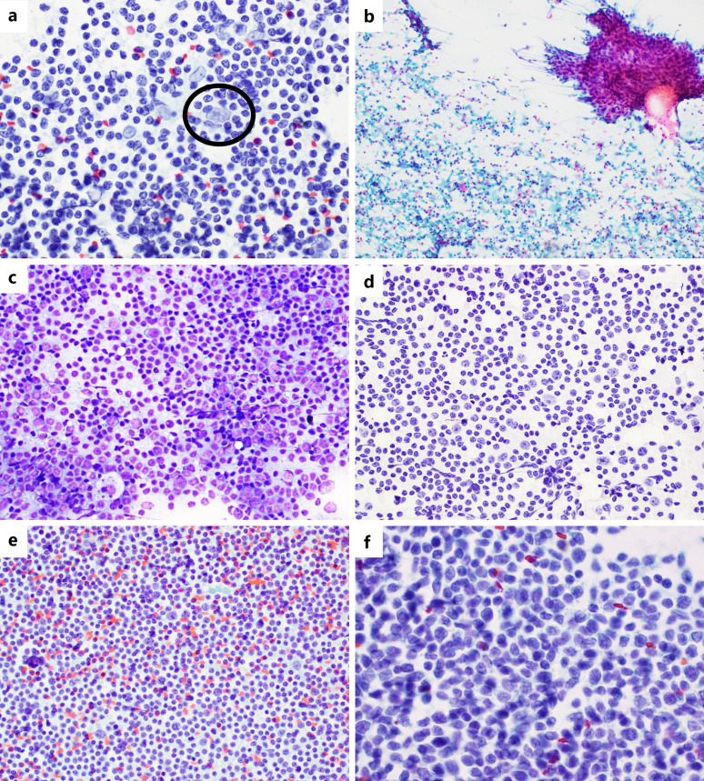
ig. 1. Entities causing potential FN diagnoses. a NLPHL with a rare LP cell (circle) that may be mistaken for immunoblasts (Pap stain, × 40). b OPSCC, cystic metastasis, with only rare sheets of lesional cells (top right corner; Pap stain, × 4). c, d MZL showing a mixed lymphoid population with predominant small- to medium-sized lymphocytes, mimicking a reactive lymphoid population – a TBM is visible in the bottom left region of (c) (Hemacolor and Pap, × 20). e Low-grade FL with a mixed lymphoid population (Pap, × 20). f PTCL with irregular nuclear membranes (Pap, × 60). OPSCC, oropharyngeal squamous cell carcinoma

Slide 26
FALSE POSITIVE

Slide 27
False Positives
FP diagnoses will be discussed on the basis of the following two groups:
1. Reactive lymphoid lesions that mimic LPDs
2. Benign non-nodal lesions that mimic malignancy

Slide 28
Reactive Lymphoid Lesions That Mimic LPDs
This potential pitfall is due to sampling error or reactive conditions in which there may be a higher perceived proportion of larger lymphoid cells.
In sampling issues, the needle may pass through large reactive germinal centres, thereby yielding a disproportionately high proportion of centrocytes and centroblasts, raising a false suspicion of non-HL (NHL), especially FL or even DLBCL.
This potential pitfall may be minimised by :
  Applying a reasonable threshold for cellularity. Avoid relying on hypocellular aspirates.
  Presence of FDCs and TBMs suggests reactive follicle.
  Use FC to assess clonality (with caution if low yield).
Certain conditions that may be associated with increased numbers of larger, activated lymphoid cells such as
  Viral lymphadenitis (infectious mononucleosis syndrome [IMS]), human immunodeficiency virus infection,
  autoimmune disease,
  histiocytic necrotising lymphadenitis (e.g., KFL),
  post-COVID-19 vaccination changes,
  progressive transformation of germinal centres (PTGCs).

Slide 29
IMS:
  Reported case of IMS showing cellular smears with a predominance of large cells with increased mitotic figures, accompanied by the absence of TBMs, which prompted a diagnosis of “suspicious for lymphoma.”
  Can mistakenly diagnosed as HL and large cell lymphoma.
  Clue IMS: Polymorphous nature of the aspirates, displaying a spectrum of maturation with a mixture of smaller mature lymphocytes and plasma cells as well as larger immunoblastic and plasmacytoid cells.
  Binucleate immunoblasts were present in 50% , but did note closely resemble diagnostic ReedSternberg cells
  Clinically suspicious features: significantly enlarged lymph nodes (which may be as large as 4 cm), malaise, and weight loss

Slide 30
HIV:
  Reported to cause disproportionately increased numbers of larger lymphocytes and even clonal B-cell proliferations,
  Combined FC and cytology may point strongly towards an FP diagnosis of lymphoma
  May require histologic biopsy in order to arrive at the diagnosis of reactive lymphoid hyperplasia.

Slide 31
Histiocytic necrotising lymphadenitis, seen in the self-limiting KFL or in autoimmune conditions,
  disproportionately increased numbers of larger, activated lymphocytes, thus giving the initial impression of possible lymphoma.
  KFL in Asian population and affects young adults, more frequently females.
  Small lymphocytes admixed with larger lymphocytes which may be immunoblasts or plasmacytoid monocytes,
  Conspicuous karyorrhectic debris, either within macrophages or in the background. Neutrophils are usually not identified.
  A useful diagnostic clue:
    crescentic histiocytes – macrophages with an eccentric, crescent shaped nucleus and cytoplasmic apoptotic debris
    Epidemiologic clue - adult, Asian origin, → trigger an active search for apoptotic debris and crescentic histiocytes.
    Constitutional symptoms such as weight loss or fever may be present
    IHC may be helpful - CD123 and myeloperoxidase highlighting the plasmacytoid monocytes and histiocytes,

Slide 32
Post-vaccination lymphadenopathy has been well documented, particularly in the setting of mRNA vaccines,
  Radiology showing worrying features such as lymph nodes with increased FDG uptake, or significant lymphadenopathy, which may be associated with tenderness
  Spectrum of changes includes the presence of granulomatous inflammation, florid reactive hyperplasia, atypical lymphoid proliferation, PTGC, reactive hyperplasia with increased TBMs, and even features of KFL.
  Reported FNAC findings:
    Polymorphous lymphoid population with numerous large cells with prominent nucleoli, some of which contained bilobed nuclei.
    Some cases shows numerous TBMs, as well as KFL-like features
  Clues
    history of recent vaccination would be helpful.
    Lymphadenopathy often occurs within a week of vaccination
    Occurs in the cervical, supraclavicular, or axillary regions, with a few reports documenting mediastinal lymphadenopathy
    In most instances, the lymphadenopathy is self-limiting, resolving within weeks to months

Slide 33
PTGC in which germinal centres are enlarged three- to fivefold, with expansion of the mantle zone into the germinal centre - may be worrying for NLPHL or FL.
  On cytology, FP diagnoses of HL and FL have been documented.
  Monolobated Hodgkin-like cells or LP-like cells may be seen within the expanded follicles, closely mimicking NLPHL on cytology.
  However lymphoma, particularly NLPHL, may be seen in association with PTGC, either occurring concurrently with PTGC or developing after an interval.
  Histologic differences between PTGC and NLPHL involved evaluating the immunoarchitecture and PD1positive T cells.
    This would be difficult to appreciate on cytologic aspirates and even on CB.
  Histologic biopsy may be needed to assess immunoarchitecture.

Slide 34
Benign Non-Nodal Lesions That Mimic Malignancy
Common in Cervical Region:
  Salivary gland lesions (e.g., parotid, submandibular).
  Subcutaneous/adnexal tumours (e.g., pilomatrixoma, hidradenoma, eccrine tumour- hidradenoma)
When epithelial cells are identified in an aspirate labelled as a 'lymph node,’ the usual cytomorphologic features of malignancy (e.g., architectural and nuclear atypia) should be present before making a diagnosis of metastatic carcinoma, rather than just the presence of any epithelial cells.

Slide 35
PMXs
  often yield highly cellular aspirates featuring sheets of basaloid cells with high N/C ratios,
  sometimes with frequent mitotic figures,
  keratinous material - may be mistaken for atypical keratinised cells
  useful clues:
    presence of ghost cells or “shadow cells,”, calcified material, multinucleated giant cells, and chronic inflammatory cells
    Ghost or shadow cells are recognised as sheets of cells with dense orangeophilic cytoplasm and a central pale, empty area where the nucleus used to be, represent differentiation towards the hair cortex.
  The commonest FP diagnoses include metastatic SCC or basaloid carcinoma [54, 55].
  Consider patient’s age and the location of aspirate
    In a child, teenager, or young adult with a surprisingly cellular smear filled with cohesive sheets of epithelial cells, consider PMX.

Slide 36
Warthin tumour:
  May mimic metastatic SCC.
  Sampling of cystic areas yield degenerate squamous-like cells with pyknotic or irregular nuclei and homogeneous orangeophilic cytoplasm, closely mimicking keratinising SCC
  Reported case of atypical squamous cells and abundant necrotic debris.
  True squamous metaplasia may occur.
  Both WT and Metastatic SCC may harbour lymphocytes with confounding clinical features a smoking history and difficulty delineating the true nature of the swelling (i.e., nodal vs. arising in a salivary gland), even with imaging.
  Useful clue in WT vs metastatic SCC :
    Presence of sheets of bland oncocytic cells and lymphocytes, with only small numbers of atypical orangeophilic cells within a cystic background.
      In metastatic SCC, bland oncocytic cells are not present, crowded sheets of malignant cells with nuclear overlapping and enlargement, raised N/C ratios
      history of head and neck SCC is also a useful, → metastatic SCC potentially being cystic with purulent material, abundant acute inflammatory cells and a relative paucity of atypical squamous cells.

Slide 37
Lymphoepithelial cysts or branchial cysts may occasionally yield atypical squamous cells.
  Risk of misdiagnosis as metastatic SCC.
In case of cystic head and neck lesions yield atypical squamous cells on FNAC:
  correlation with imaging and otolaryngological examination
  On cytology, search for bland oncocytic cells - suggest WT, and sheet of atypical cells with significant architectural and nuclear atypia – favour metastatic SCC.

Slide 38
Other differential diagnosis should be considered, includes
  soft tissue lesions (e.g., nodular fasciitis), pleomorphic or spindle cell lipoma, and nerve sheath tumours.
  Some architectural clues as well as relevant ICC tests may be done, e.g., CD34 for spindle cell lipoma, SMA for nodular fasciitis, and S100/SOX10 for schwannoma.

Slide 39
Lymphangioma mimicking lymphoma
  presence of usually small and monotonous-appearing lymphocytes
  lateral neck is a common location,
  rich lymphoid yield may potentially give an impression of a lymphoid lesion with small cell morphology.
  aspirates are often strikingly monotonous, appear mature with condensed chromatin and lack the features of SLL (i.e., coarsely clumped, so-called soccer ball chromatin) or irregular nuclear contours of mantle cell lymphoma.
  Clue:
    Review of the procedural notes or gross aspirate description may suggest cystic nature of the aspirate.
    Where fluid is aspirated, it is usually straw-coloured or turbid –lymphoma less likely.
    Where available, imaging are useful- cystic lesions with or without septations and usually without solid areas [61, 62].

Slide 40
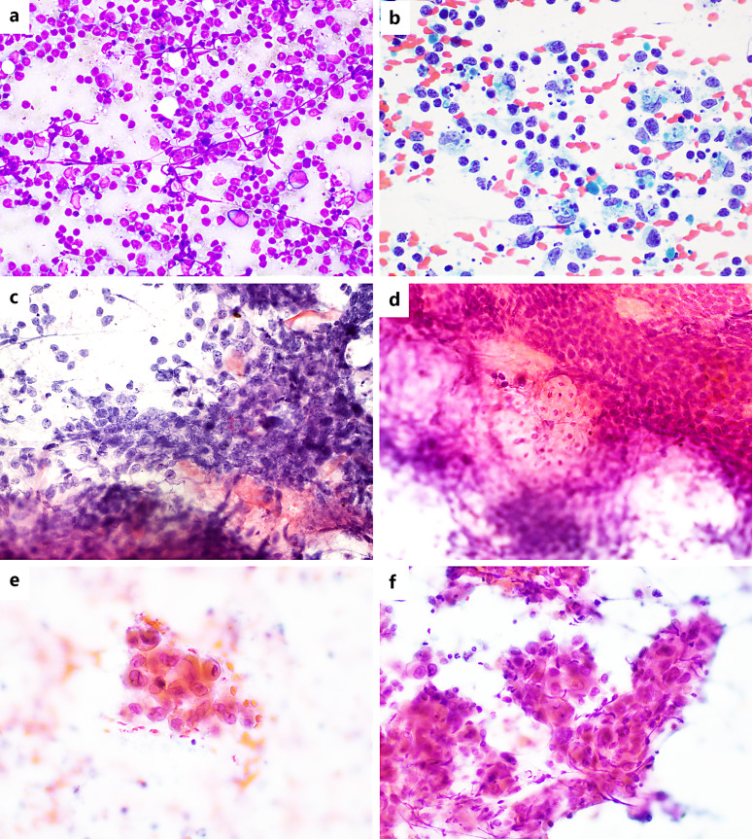
Fig. 2. Entities causing potential FP diagnoses. a KFL with increased numbers of activated, large lymphocytes, superficially mimicking lymphoma with large cell morphology (Hemacolor, × 40). b KFL showing prominent crescentic histiocytes (Pap, × 60). c PMX showing seemingly crowded sheets of basaloid cells with hyperchromatic nuclei (Pap, × 40). d PMX showing nucleated epithelial cells transitioning to ghost cells (Pap, × 40). e WT featuring atypical orangeophilic cells closely mimicking keratinising SCC (Pap, × 20). f Metastatic SCC showing diagnostic crowded, disorganised sheets of cytologically malignant cells (Pap, × 20

Slide 41
MISCLASIFICATION OF TUMOUR

Slide 42
This section will be divided into 2 main categories:
  1. Lymphoma versus non-lymphoid malignancy
  2. Lymphomas mimicking each other

Slide 43
Lymphoma versus Non-Lymphoid Malignancy
Because lymphocytes are usually significantly smaller than epithelial cells, only lymphomas such as DLBCL, ALCL, and HL tend to be potentially mistaken for nonlymphoid malignancies and vice versa.
  mistaken for metastatic carcinoma due to either larger cell size or apparent aggregation of neoplastic large lymphocytes, (mimic cohesive groups of malignant epithelial cell)
  Poorly differentiated or undifferentiated carcinoma, (esp when dispersed malignant cells) may be mistaken for lymphoma.

Slide 44
Helpful clue:
  In lymphoid aggregates, individual cell borders are often still discernible when focusing through the aggregate, (syncytial sheets of malignant epithelial cells, cytoplasmic borders are more ill-defined)
  Presence of Lymphoglandular Bodies (LGBs):
    - Helpful in identifying lymphoid origin. - Abundant in lymphoid aspirates.
    May also appear in small cell carcinoma or Ewing sarcoma (less frequent).
    Absent in ALCL (potential pitfall). Clues that suggest ALCL: - Dispersed large cells. - Embryoid-shaped nuclei (hallmark cells). - Multinucleated cells with wreath-like nuclei.

Slide 45
In small cell carcinoma and undifferentiated NPC.
  Careful attention to nuclear chromatin is very helpful
  Small cell ca- chromatin is more evenly granular, compared to more coarsely clumped chromatin or prominent nucleoli in lymphoma with large cell morphology
  The presence of abundant LGBs in lymphoid neoplasm closely associated with lesional cells and not just around non-neoplastic lymphocytes

Slide 46
Undifferentiated NPC,
  Aspirates may appear discohesive, leading to an initial impression of lymphoma
  Syncytial sheets of cells with oval to elongated nuclei with vesicular chromatin and central prominent nucleoli may resemble epithelioid granulomas
  it is important to remember also that true small granulomas may occur in this setting
  Nuclear crowding and overlap, nuclear size, and the presence of prominent nucleoli that would suggest NPC
  The vesicular chromatin of NPC and central conspicuous nucleolus are also not typical of lymphoma.

Slide 47
HL may also be mistaken for carcinoma and vice versa.
Conversely metastatic NPC has been mistaken for classic HL and ALCL.
CB, with ICC can help differentiating –
  CAM.2 or pancytokeratin for carcinoma versus CD3 and CD20 in lymphoma.
  synaptophysin and chromogranin in small cell carcinoma and EBER-ISH in undifferentiated NPC.

Slide 48
Mesenchymal tumours:
  Sarcomas with small round cell or epithelioid morphology, such as alveolar rhabdomyosarcoma, Ewing sarcoma, or epithelioid angiosarcoma may be misdiagnosed as lymphomas (DLBCL and ALCL) or metastatic carcinoma.
  Sarcomas usually metastasise via the bloodstream, those with round cell or epithelioid morphology may metastasise to lymph nodes.
  ICC on CB will be helpful.
    pathologist to be aware of the differentials and apply a judicious panel of discriminatory markers.
    Basic panel of CD3 and CD20 may missed ALCL,
    Thus, where ALCL is a viable differential, CD45 should be included; CD30 and EMA may also be considered, which, though not specific, would also highlight HRS cells in HL, in addition to ALCL.

Slide 49
Syncytial variant of nodular sclerosis subtype of HL
  Challenging due to large numbers of large pleomorphic malignant cells and aggregation of these cells.
  may mimic metastatic malignancies with pleomorphic large cells, such as metastatic poorly differentiated carcinoma, sarcoma, germ cell tumours, and melanoma.
  In such cases where large pleomorphic cells raise differential diagnoses that span epithelial, melanocytic, mesenchymal, and lymphoid malignancy, a broad initial panel including cytokeratins, Melan A/S100, CD45, CD3, CD20, and vimentin may be considered, as well as SALL4 (a reliable marker for many germ cell tumours).
  In such cases, a thorough search for a history of known malignancy is also prudent, as well as correlation with imaging and relevant tumour markers.

Slide 50
Lymphomas Mimicking Each Other
Some haematolymphoid malignancies mimicking each other.
A prime example is HL which may mimic a spectrum of NHL including ALCL, DLBCL, THRLBCL, AITL, PTCL, and primary mediastinal large B-cell lymphoma.

Slide 51
Lymphomas Mimicking Each Other
Undersampling of large malignant lymphocytes, (e.g., partial involvement by DLBCL or ALCL) → may lead to an impression of scattered large HRS-like cells on a background of small lymphocytes, which is the characteristic pattern of HL.
HL itself can mimic ALCL, when the cells are large and pleomorphic,.
CB may only be of some help in this scenario, but when the number of large cells is limited, ICC should be interpreted with caution.
CD30 is unhelpful in this context, with other markers being more discriminatory, such as CD15 and PAX 5 for HL; and CD45, granzyme B, TIA, and ALK1 for ALCL, among other antibodies.

Slide 52
Lymphomas Mimicking Each Other
THRLBCL can mimics the lesional cell-poor pattern of HL, both classic HL and NLPHL, with scattered large neoplastic cells on a background of smaller cells.
The paucity of neoplastic large cells (<10% of the entire cell population) and to their close resemblance to HRS cells, considered to be nearly impossible to diagnose on cytology.

Slide 53
Lymphomas Mimicking Each Other
Careful attention to the immediate surrounding and background cellular, which can be difficult to appreciate on cytology and CB.
  NLPHL very closely resembles THRLBCL both morphologically and immunophenotypically, and attention to the background cellular picture is thus required, e.g., the rimming of neoplastic B cells with PD-1 and CD57positive T cells in the former.
  FC may not help in scenarios where neoplastic cells form the minority population.
  AITL and PTCL may also exhibit HRS-like cells that can easily be mistaken for HL
  In AITL, histologic features such as prominent high endothelial venules and expanded FDC meshworks are especially helpful
  these are difficult or sometimes impossible to appreciate on cytology or CB.
  Immunophenotypically, true HRS and HRS like cells in AITL are often indistinguishable.

Slide 54
In PTCL, the presence of HRS-like cells has been well recognised, and the diagnosis is often one of exclusion, with demonstration of a whole spectrum of atypical T cells and the establishment of clonality, together with clinical and epidemiological correlation.
In the spectrum of entities with HRS-like cells, histoarchitectural features and the immunophenotypic make-up of the entire cell are often important; hence, it may be wise to recommend incisional or excisional biopsy to confirm diagnosis of HL and its close cytologic mimics

Slide 55
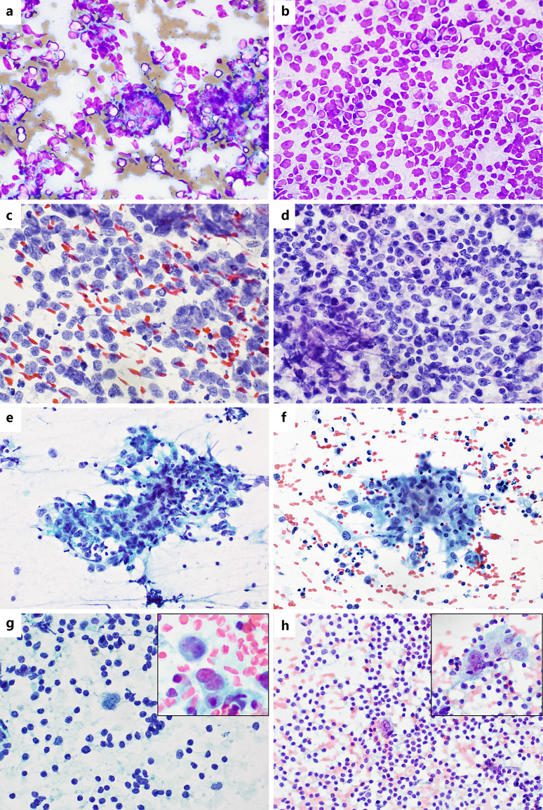
Fig. 3. Neoplastic entities that may be misclassified as other neoplasms. a DLBCL with cohesive appearing aggregates, mimicking carcinoma (Hemacolor, × 40). b Metastatic NPC with discohesive cells, mimicking NHL (Hemacolor, × 40). c Metastatic small cell carcinoma with dispersed cells; finely granular, even chromatin without prominent nucleoli (Pap, × 40), in contrast to (d) DLBCL with nuclei of similar size, but with coarser chromatin and prominent nucleoli (Pap, × 40). e Syncytial sheet of malignant cells with oval, vesicular nuclei and prominent nucleoli (Pap, × 20), which may appear similar to epithelioid granuloma, as shown in (f), in which the cells have lower N/C ratios, a more haphazard nuclear arrangement and less prominent nucleoli (Pap, × 20). g ALCL with HRS-like cells on a background of small lymphocytes; inset shows binucleated RS-like cells (Pap, × 60). h AITL showing scattered large HRS-like cells on a background of smaller lymphocytes, mimicking HL; inset shows a binucleated RS-like cell (Pap, × 40).

Slide 56
OFF-RADAR ENTITIES

Slide 57
Off-Radar Entities
These uncommon entities include follicular dendritic cell sarcoma (FDCS), Langerhans cell histiocytosis (LCH) which can occasionally involve lymph nodes, and Rosai-Dorfman disease (RDD).
These entities may be misdiagnosed as either reactive or other neoplastic entities,
Others- common lymphomas such as FL or other NHLs which can rarely exhibit unusual morphologic features such as signet ring cell or spindle cell morphology.

Slide 58
Follicular Dendritic Cell Sarcoma (FDCS)
  May potentially be mistaken for non-neoplastic entities such as granulomatous lymphadenitis, lymphoma, metastatic lymphoepithelial carcinoma (especially undifferentiated NPC), metastatic sarcomatoid carcinoma, metastatic melanoma, and spindle cell mesenchymal tumours.
  FDCS is composed of syncytial sheets or fascicles, and sometimes storiform arrangements, of spindle cells admixed with small background lymphocytes.
  The lesional cells are spindle-shaped, with elongated nuclei featuring pale vesicular chromatin and prominent nucleoli, nuclear pseudoinclusions, and eosinophilic cytoplasm.
  Necrosis and mitotic counts are variable.
  In any spindle cell lesion in a lymph node, especially in no oncologic, or if a history of Castleman disease is present, FDCS should be considered.
  Distinctive immunoprofile - positive for CD21, CD23, CD35, and CXCL13, and negative for usual lymphoid markers (CD45, CXD3, CD20), most cytokeratins and usual histiocytic markers.

Slide 59
Langerhans Cell Histiocytosis (LCH)
  LCH usually involves extranodal sites but occasionally can involve lymph nodes.
  The main differential diagnoses - granulomatous lymphadenitis, histiocytic reactions including dermatopathic lymphadenitis, Kimura disease, RDD, melanoma, and rarely HL.
  LCH usually shows variable numbers of epithelioid Langerhans cells with round to oval, indented or convoluted nuclei with nuclear grooves. Bi- or multinucleation is frequent.
  Prominent eosinophils may be seen in the background, raising a differential of Kimura disease (eosinophils are more numerous, accompanying endothelial cells and occasional collagenous fragments)
  Langerhans cells can also be seen in dermatopathic lymphadenitis; however, there are usual accompanying melanin-containing histiocytes and proliferating capillaries, and an appropriate dermatologic history should be sought.

Slide 60
Rosai-Dorfman Disease (RDD):
  RDD may mimic lymphoma, often lymphadenopathy in multiple sites
  Documented errors in cytologic diagnoses include suspicion of NHL and HL, or nonspecific reactive lymphadenopathy, as well as granulomatous lymphadenitis.
  A differential diagnosis of LCH has also been suggested due to the presence of prominent histiocytic cells; however, LCH does not show prominent emperipolesis, and histiocytic cells are CD1a positive and exhibit characteristic twisted or grooved nuclei, unlike the histiocytes in RDD.
  The characteristic histiocyte in RDD is very large, containing one to several nuclei with fine, even chromatin and abundant cytoplasm within which are intact, viable lymphocytes and/or plasma cells.
  The engulfed cells are often surrounded by a small space within the cytoplasm of the large histiocyte.
  A combination of this classic morphology and the unusual feature of S100 reactivity (CD1a-negative) is usually sufficient to strongly suggest the diagnosis.

Slide 61
Unusual Morphologic Features in NHL
  Some NHLs may present with unexpected cytomorphological features,
  Reported an unusual case of FL with spindle cell morphology on histology, with elongated, slender nuclei that resembled spindled centroblasts and centrocytes, exhibiting the classical immunoprofile of FL, as well as the t(14;18)(q32;q21) translocation on FISH.
  Spindle cell morphology in large B-cell lymphoma and ALCL, although the former more often occurs in extranodal sites.
    These can potentially be mistaken for FDCS, metastatic sarcomatoid carcinoma, mesenchymal tumours, and melanoma.
  a variety of NHL including FL, SLL, and MZL, as well as T-cell lymphomas have been documented to exhibit signet ring cell morphology, mimicking carcinoma or non-lymphoid lesions.
  In B-cell lymphomas, the signet ring cells contain either an empty appearing cytoplasmic vacuole or eosinophilic Russell body-like globules representing IgM.
  The cells are distinguished from true signet ring cells by the eosinophilic appearance of the cytoplasmic globules, unlike the more bluish or greyish, bubbly appearance of true cytoplasmic mucin.

Slide 62
Conclusion
Pathologist must be aware of the major pitfalls and limitations of cytologic diagnosis leading to potential FN or FP diagnosis, malignancies mimicking each other, and less common entities that may otherwise not be considered.
A triple approach is recommended, which includes attention to clinical information, careful morphologic evaluation and judicious application of ancillary tests.
Recognising the dangers of hypocellular smears is important, as these may be treacherous and lead to both FN and FP diagnoses.
Understanding the limitations of histoarchitectural examination on cytology and the awareness of potentially “invisible” lymphomas such as MZL or low-grade FL is crucial.
Where a benign cytologic diagnosis is made, it is advisable to include a note recommending histologic examination if lymphadenopathy persists or progresses, or if there are suspicious clinical features.
Finally, the judicious application of ancillary techniques such as FC, CB with ICC, and molecular testing on cytologic samples can resolved some diagnostic dilemmas.

Slide 63
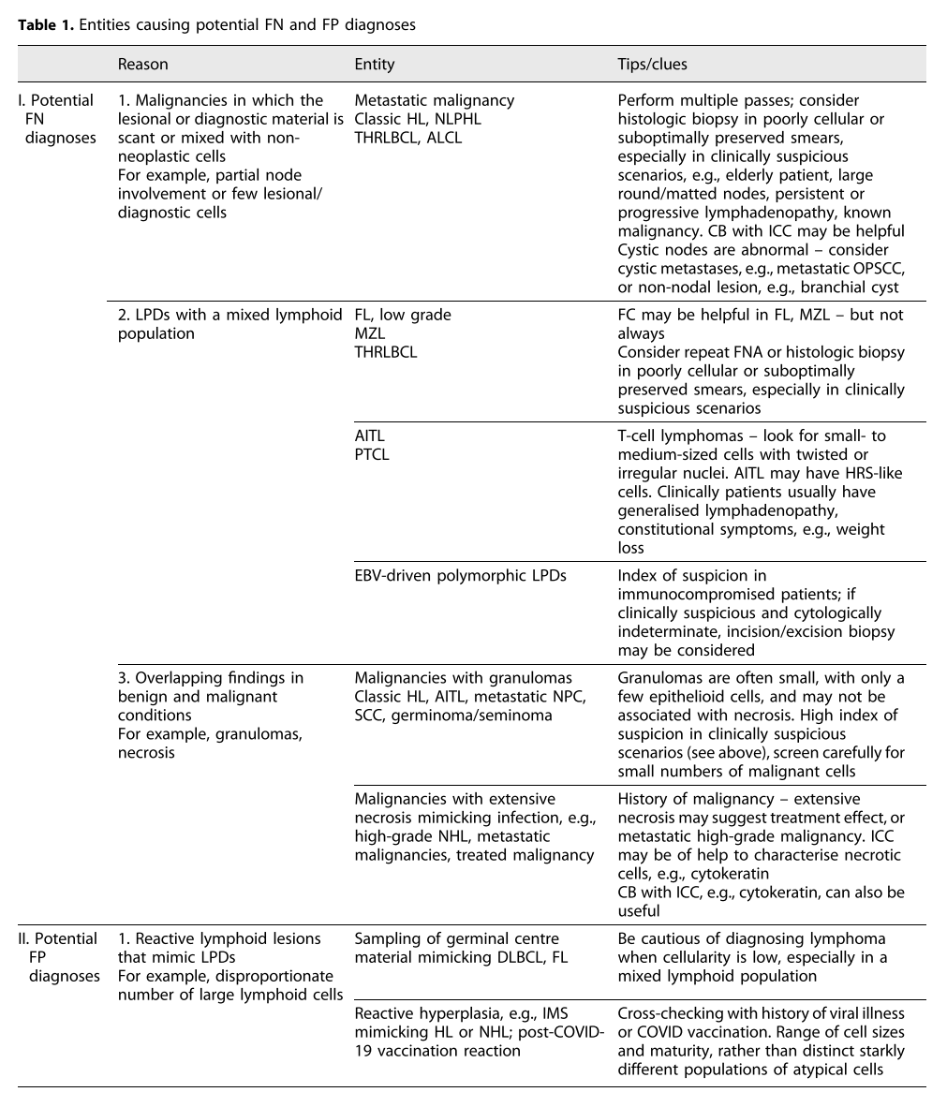

Slide 64
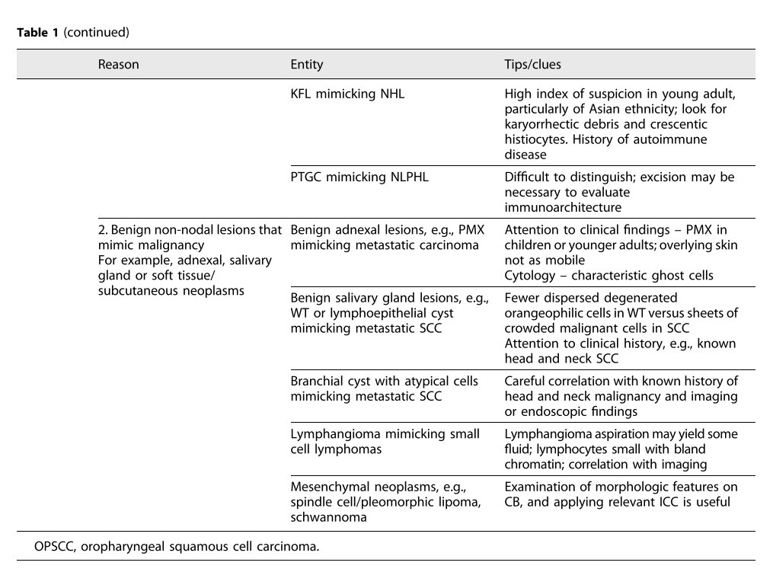

Slide 65
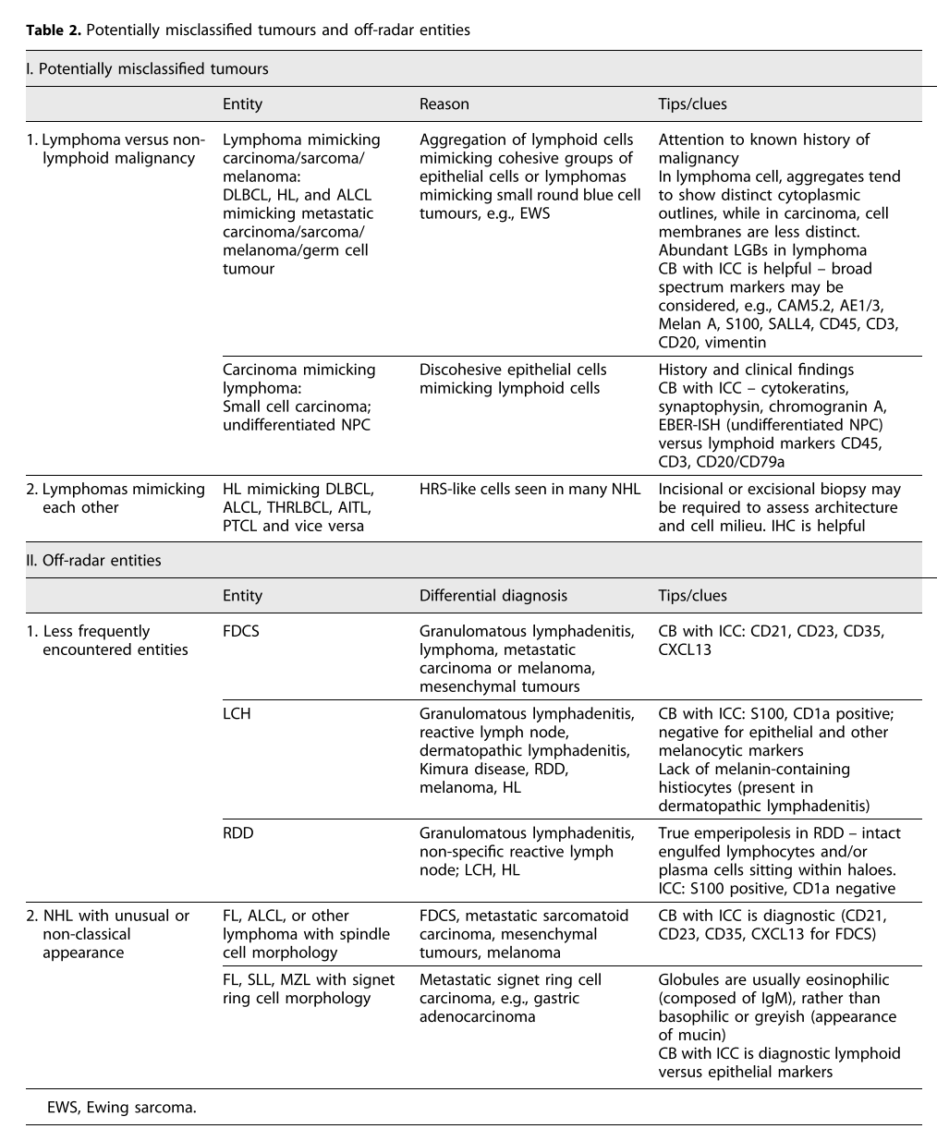

Slide 66
THANK YOU

